Slide 1
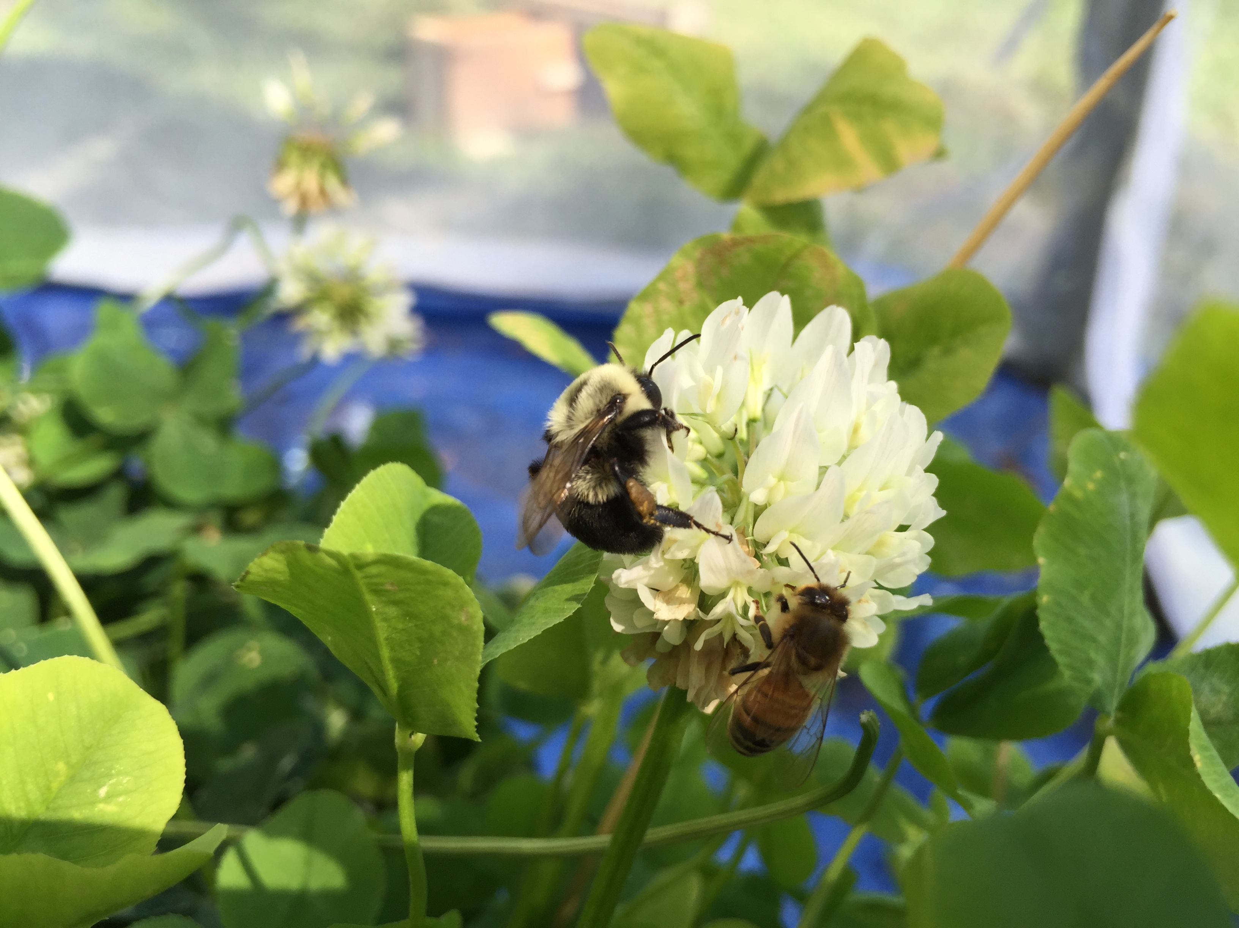

Evidence of RNA virus Spillover from Managed Honeybees to Wild Bumble Bees
Samantha Alger
Ph.D. Candidate
Department of Biology
University of Vermont

Slide 2







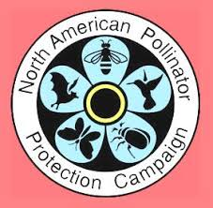


Thank you…
Alison Brody
Sara Helms Cahan
Taylor Ricketts
Joseph Schall
Alex Burnham
Humberto Boncristiani
Sarah Erskine
Kimberley Mack-Nair
Elizabeth Whalen
Sid Bosworth
UVM Greenhouse Staff
Leif Richardson
Anna Smith & Caitlin Danehy
Andrew Nguyen
Vermont beekeepers
Fabri Fialho Research Award
Ronald Suiter Travel Prize

Slide 3

esa.org
Notes:
Bees are important for both the pollination of our wild plants and agricultural crops. Without them, our fruit and vegetable choices would be very limited. Here’s a picture depicting our grocery stores without the pollination services of bees.

Slide 4
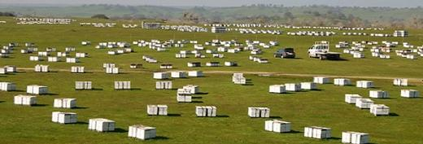
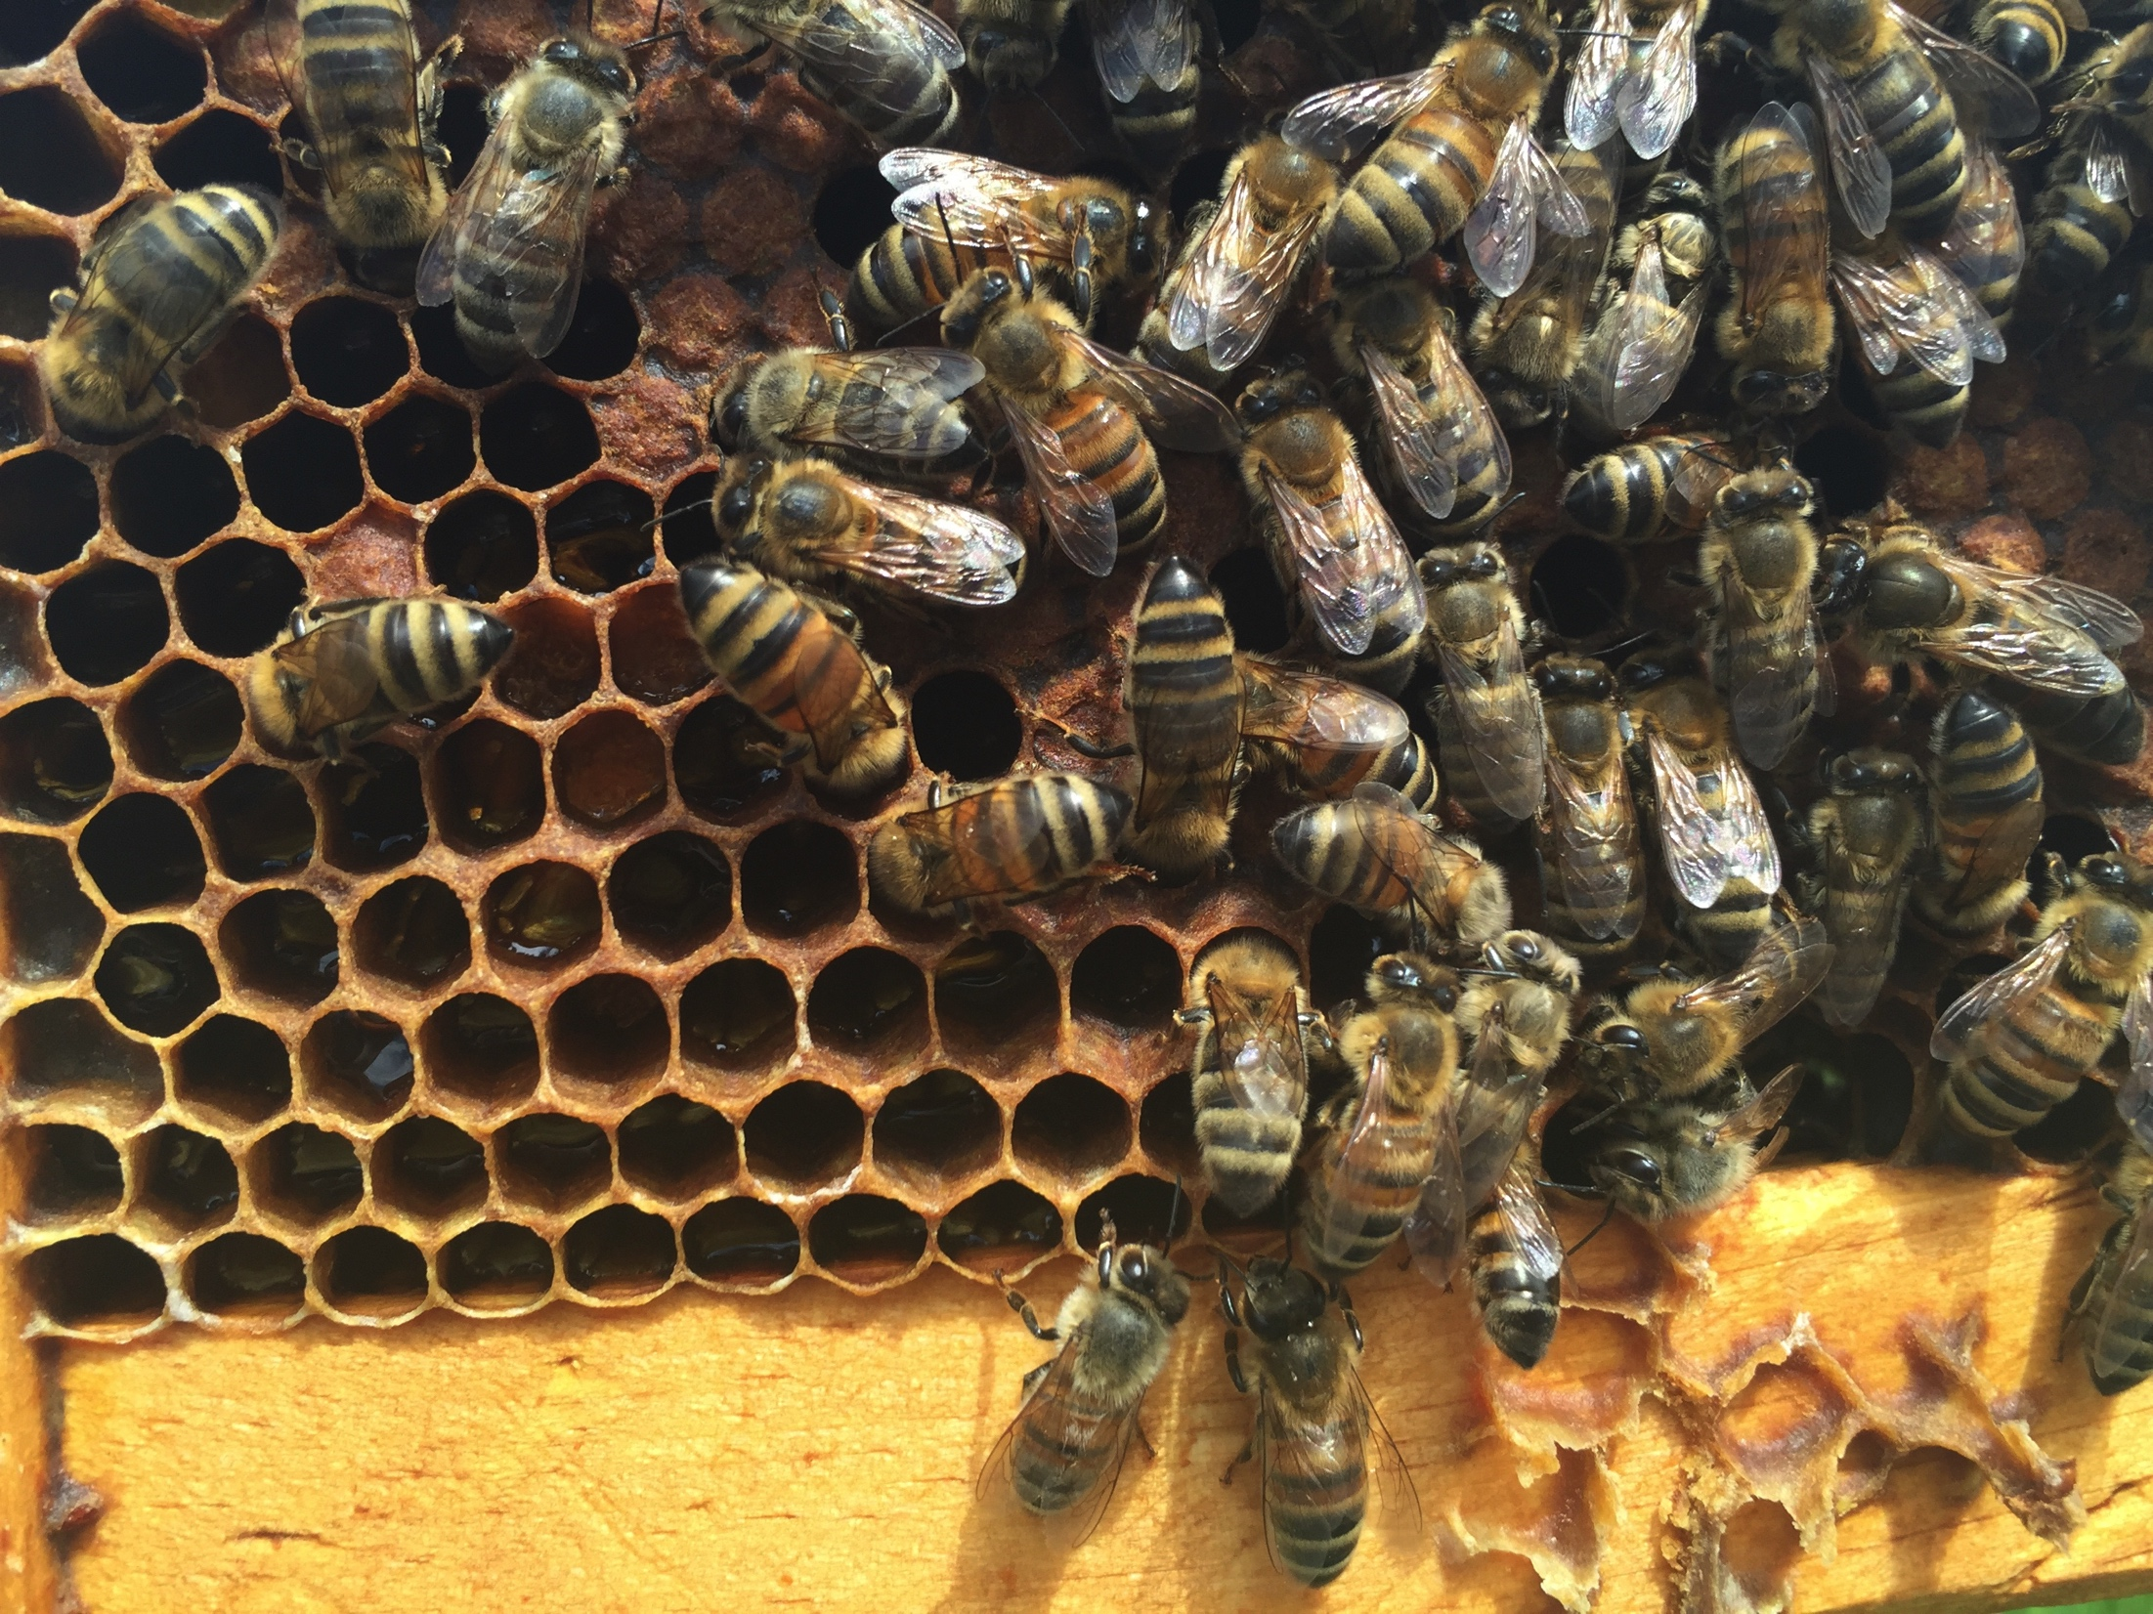
USDA.gov
US Beekeepers lost 33%
of their bees in 2016-17
-Beeinformedpartnership.org
Notes:
Most of the time, we hear about bee declines, this news is generated from statistics like these:
And in this case, and many others, the concern is over the decline of a single introduced species of bee: the European honey bee. This is a bee we managed much like an agricultural livestock animal and ship all across the US for the pollination of our crops. For example, right now as we speak, there are 1.6 million honey bee colonies pollinating almonds in california. This is about 60% of the US managed colonies converging in one place to pollinate a crop. This is a picture of honey bee colonies in a honey bee apiary- or holding yard. Many apiaries are not as industrial looking at this one.
So, when people ask me: are we all going to starve because I hear the honey bees are all dying… well.. The truth is: in my opinion, honey bees are not going to disappear. They are an important livestock animal and luckily….
1.6 million colonies to almonds (60% of US managed colonies)

Slide 5
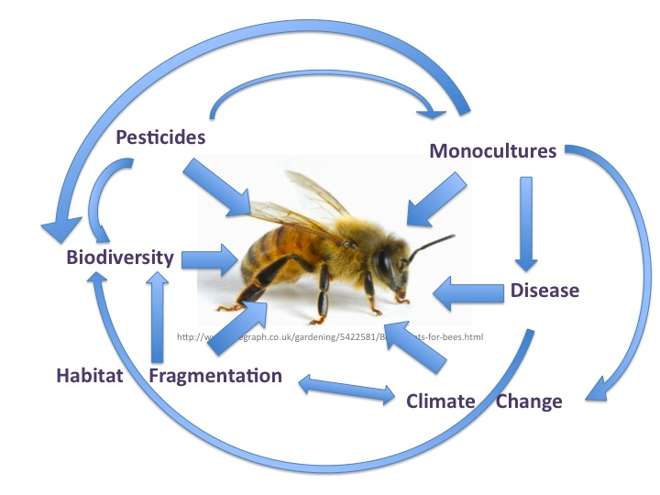
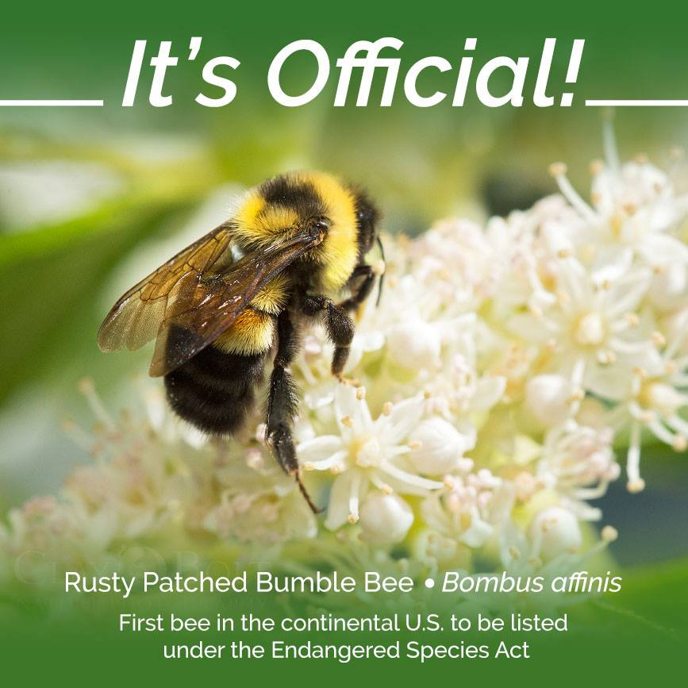
Xerces Society
Notes:
However, the the threats affecting honey bees, are also affecting our Native bee species- like this bumble bee… and this is a concern from both an economic and conservation perspective. Bumble bee declines…. My research focuses on one of these threats- disease… and in particular… the diseases that are shared by both managed and wild bees

Slide 6

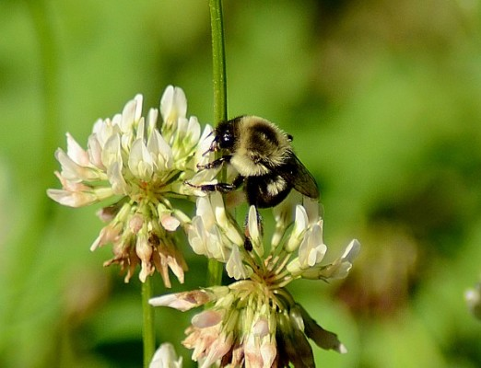
Notes:
And evidence is accumulating of spillover from managed bees to wild bees.

Slide 7
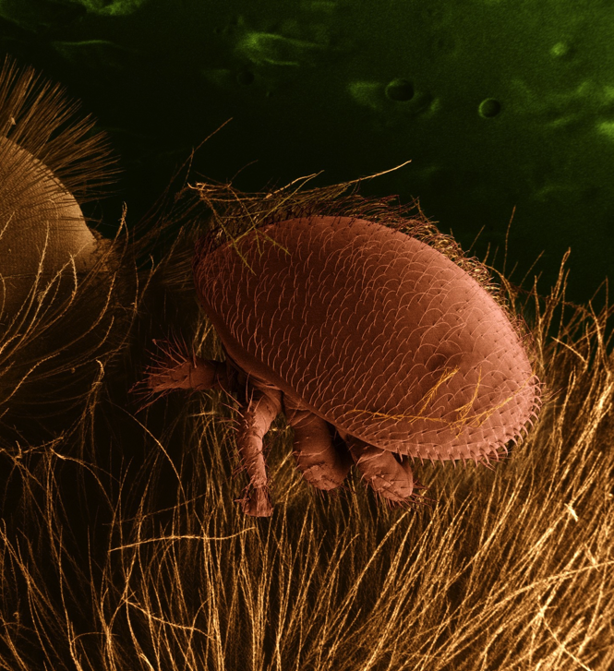
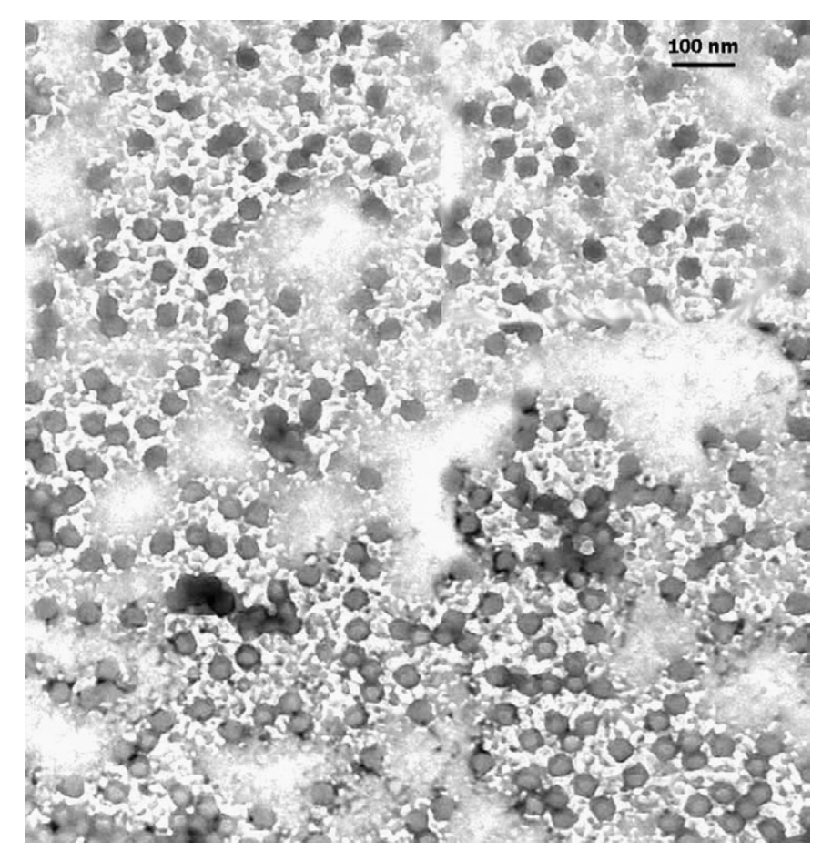
^{Deformed Wing Virus}
^{(DWV)}
^{Black Queen Cell Virus (BQCV)}
^{Israeli Acute Paralysis Virus}
^{(IAPV)}
Notes:
In particular, we know very little about the bee viruses.
The viruses we are interested in include DWV, BQCV, and IAPV. These common RNA viruses are thought to be ‘honey bee viruses’ and are best studied in honey bees. But, they have been found in many other insect species including beetles, ants, bumble bees, and solitary bees.

Slide 8
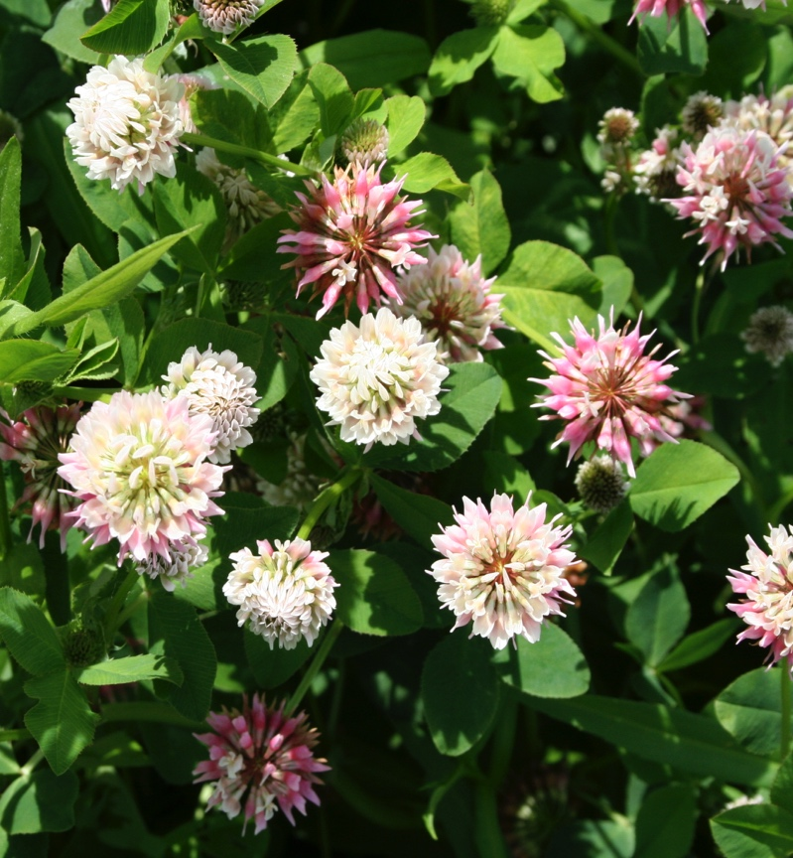
Notes:
So, you’ll remember me saying that these viruses are found in many other insect species, so how are they getting around? In the case of DWV and IAPV, mites vector viruses to honey bees. But other bee species like bumble bees are not known hosts of mites…. The standing hypothesis is through the use of shared floral resources- how they get passed to flowers

Slide 9
Research Questions
Part I.
What is the prevalence of RNA viruses in bumble bees?
Are RNA viruses replicating in bumble bee hosts?
Is there evidence for disease spillover from managed honey bees?
Part II.
What is the role of flowers in virus transmission?

Slide 10
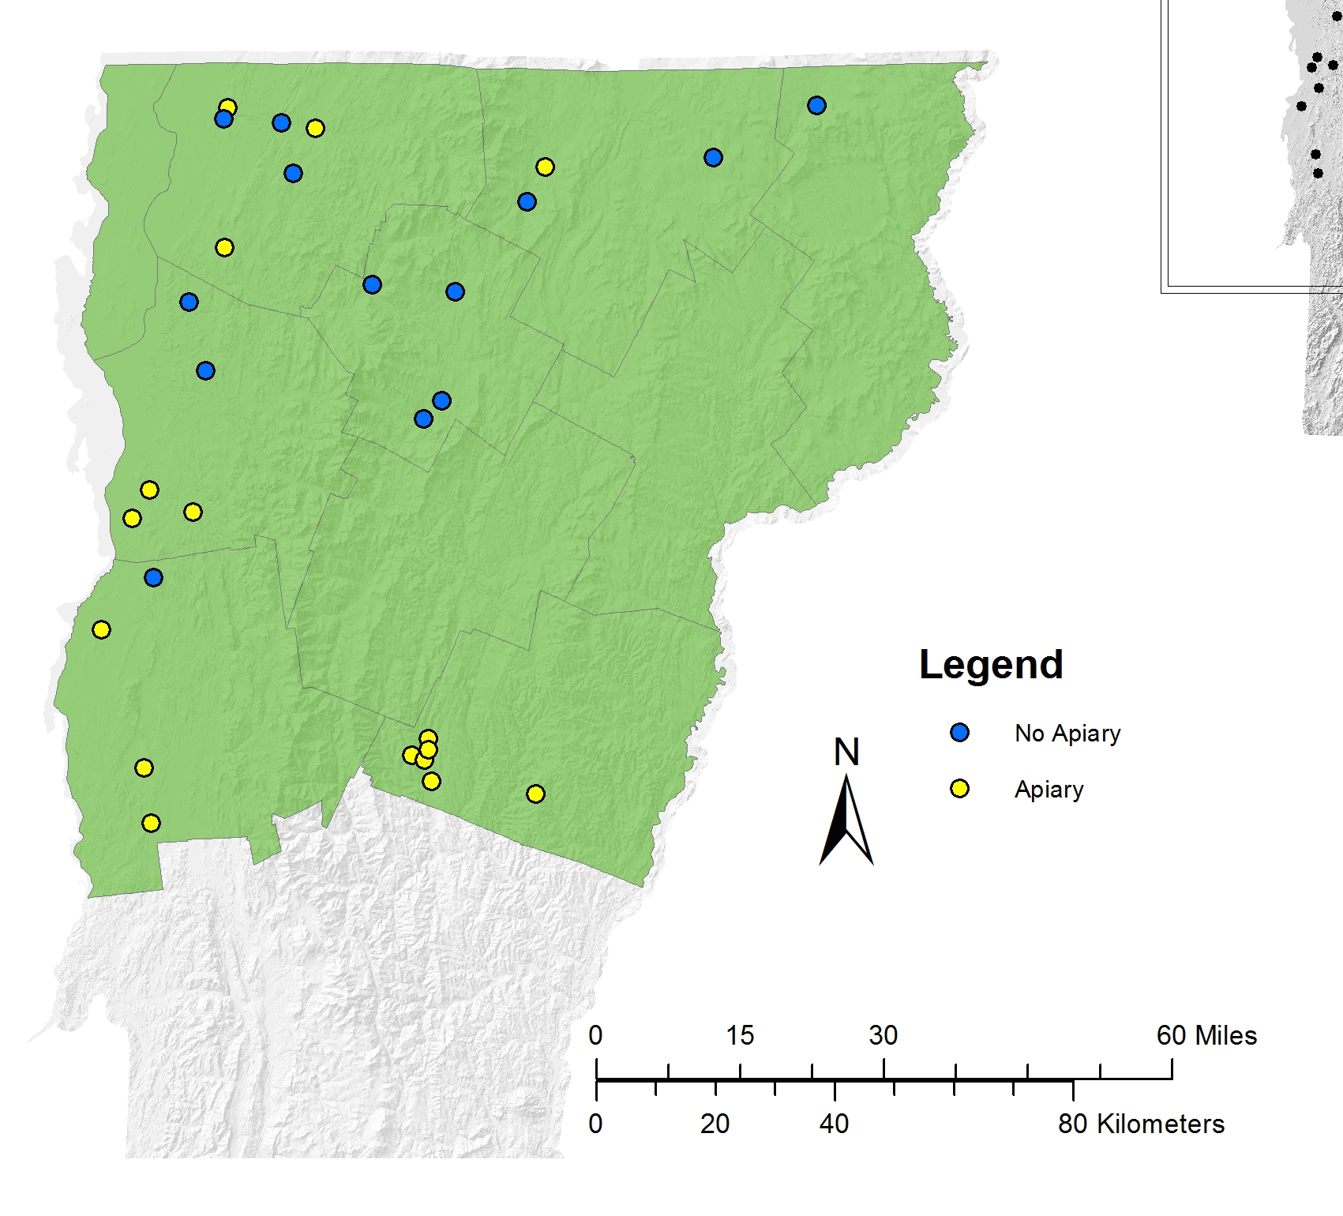
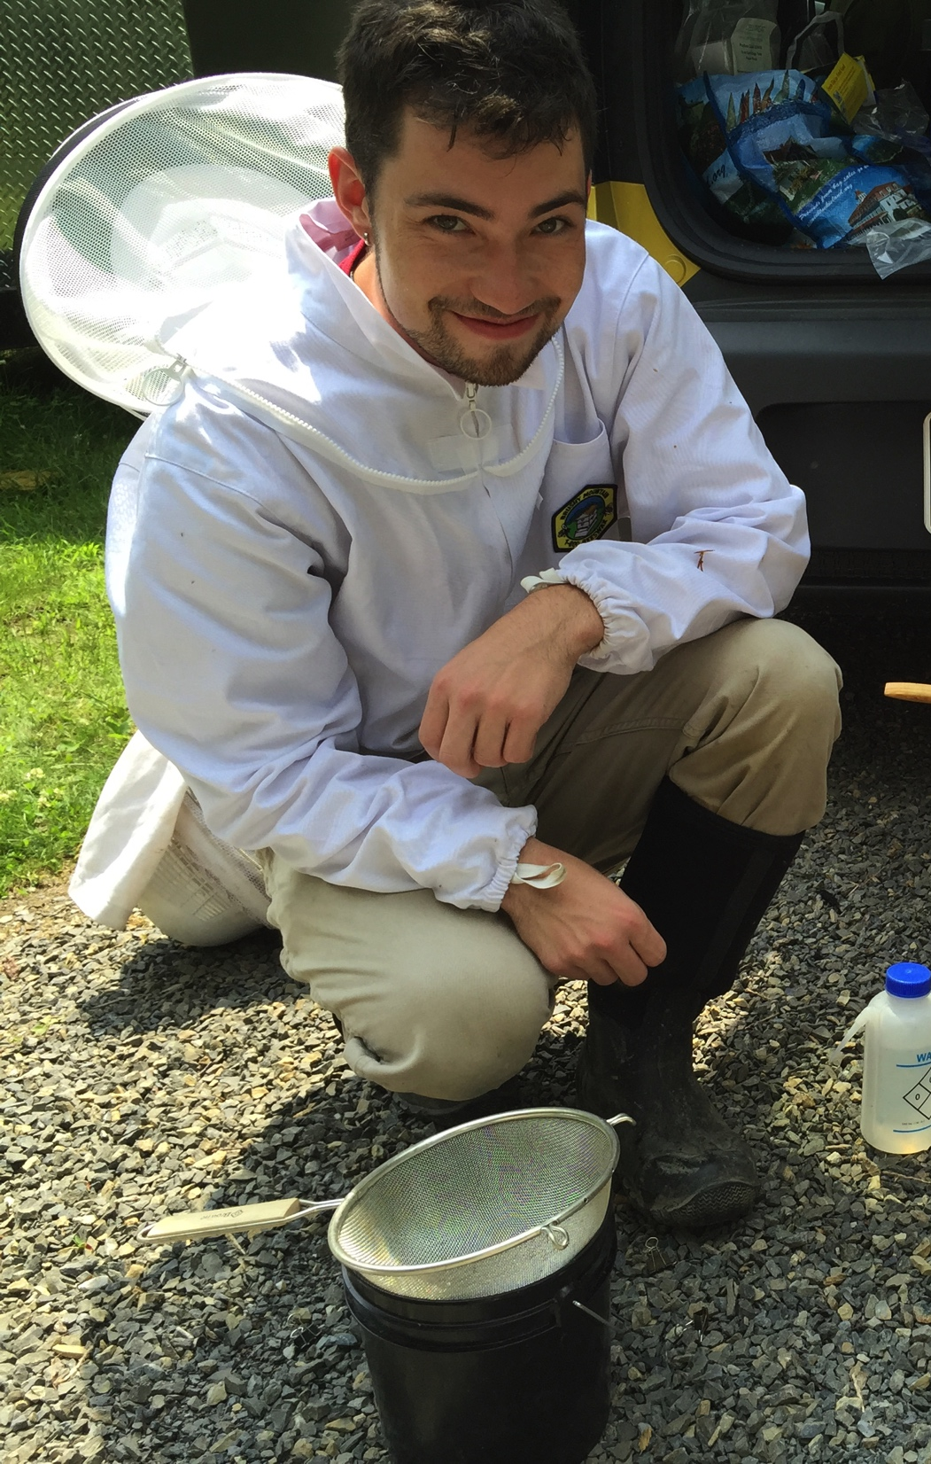

Slide 11
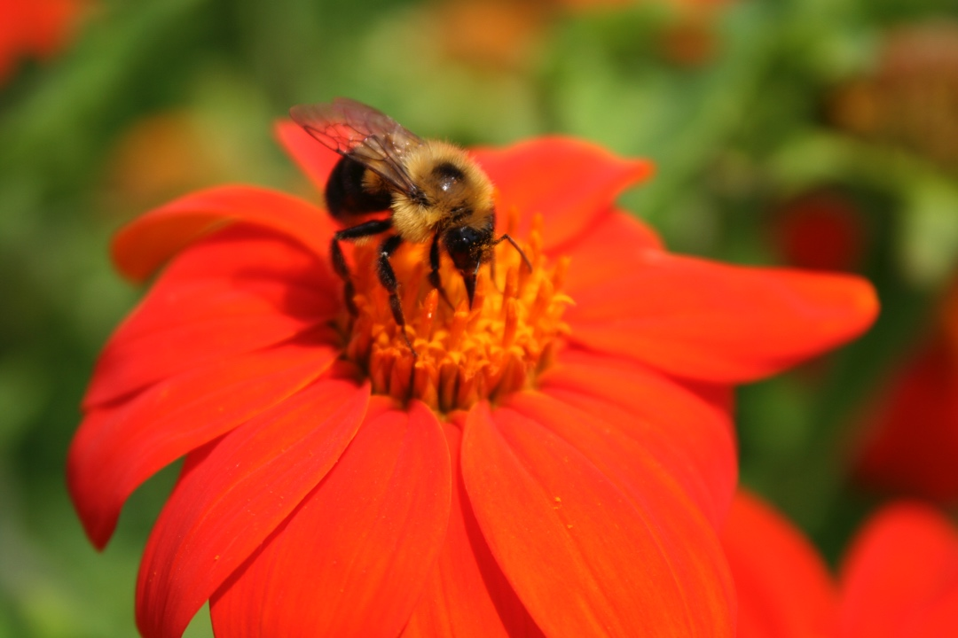
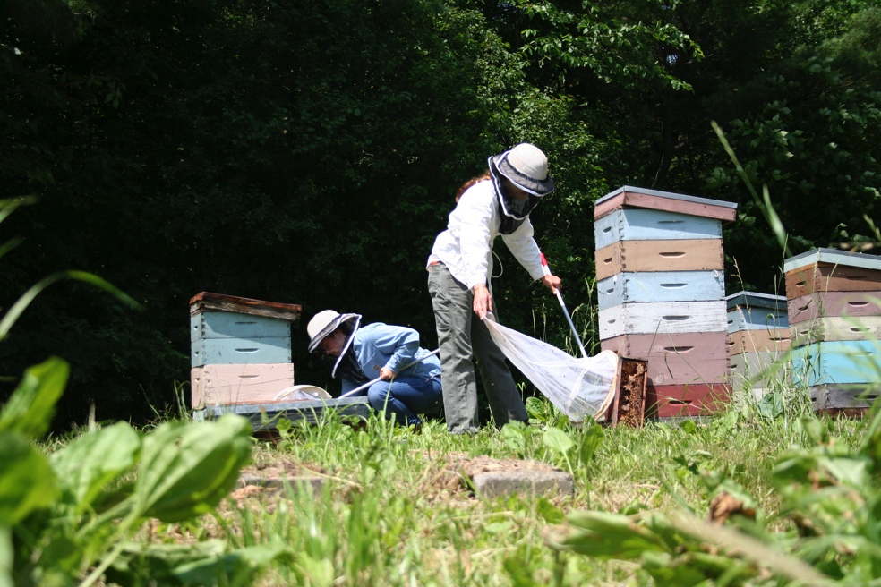
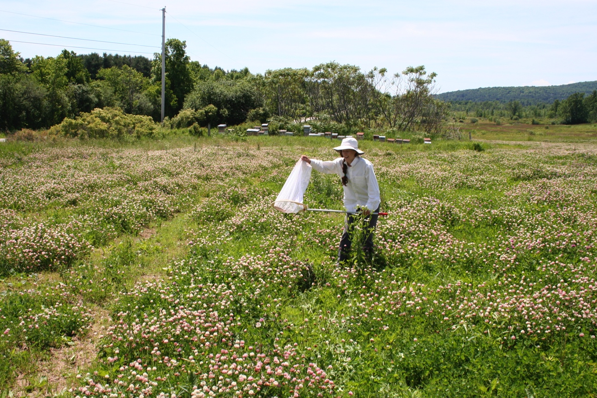

Slide 12

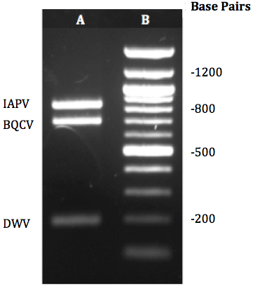

Slide 13
Viruses More Prevalent in Bumble Bees near Apiaries
*
*
*
GLMMs: BQCV: P = 0.047; DWV: P = 0.012

Slide 14
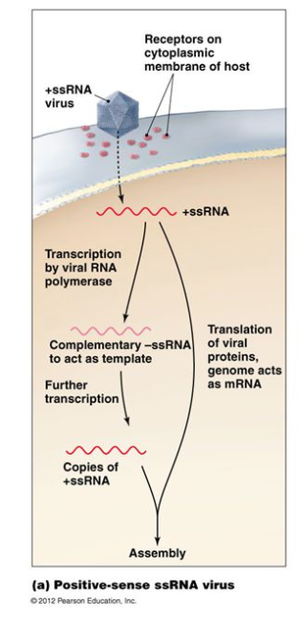
Are viruses replicating? Probe for Negative Strand

Slide 15
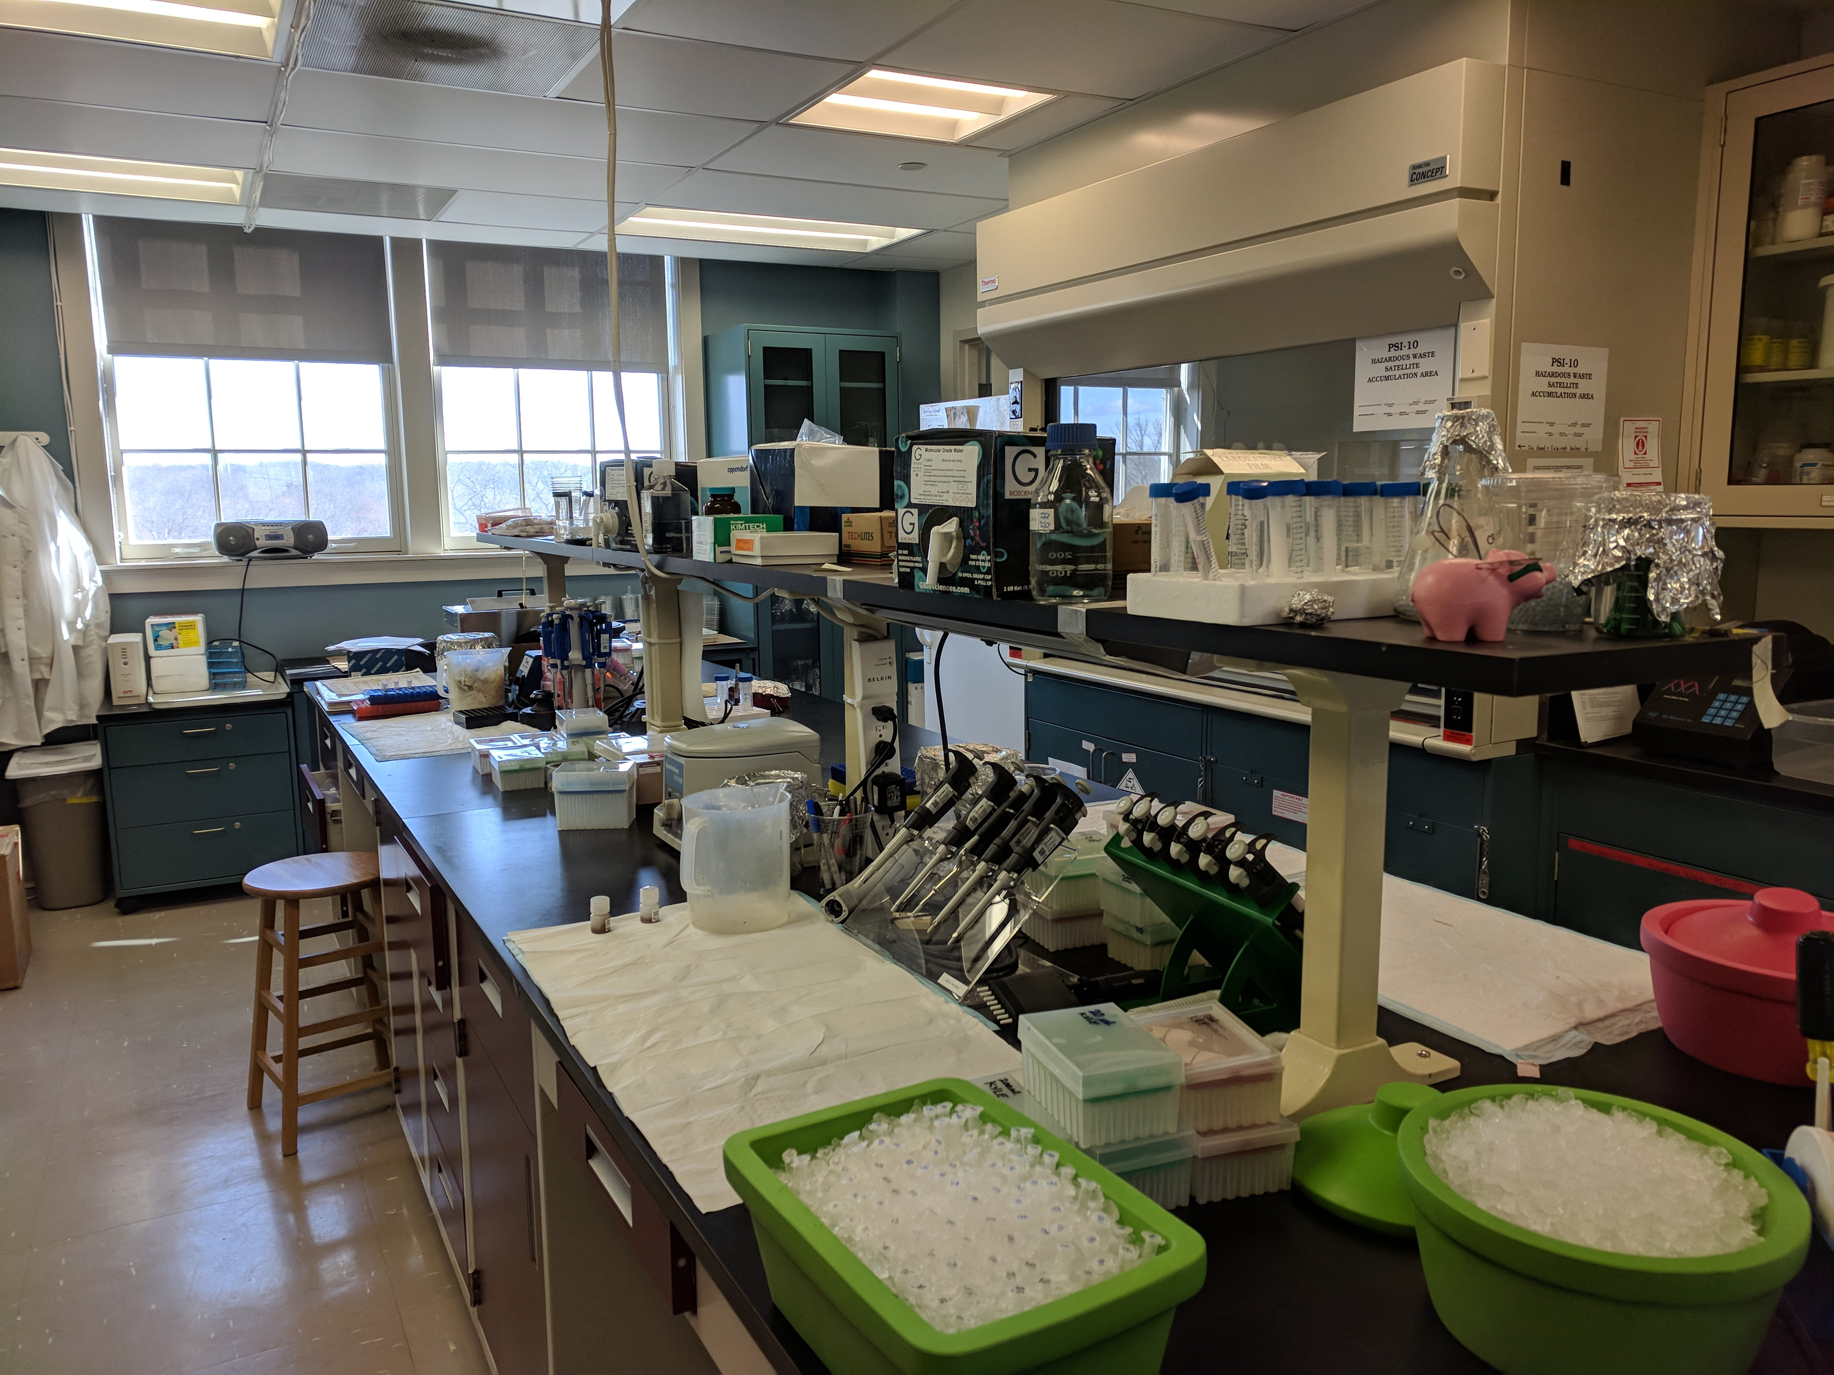


Are viruses replicating? Probe for Negative Strand

Slide 16
Are viruses replicating? Probe for Negative Strand
YES…
We detected replication in both species of bumble bees!

Slide 17
More Replicating BQCV near honey bees
*
GLMM: BQCV: P = 0.046

Slide 19
Honeybee DWV Load Results: Either High or Low

Slide 20
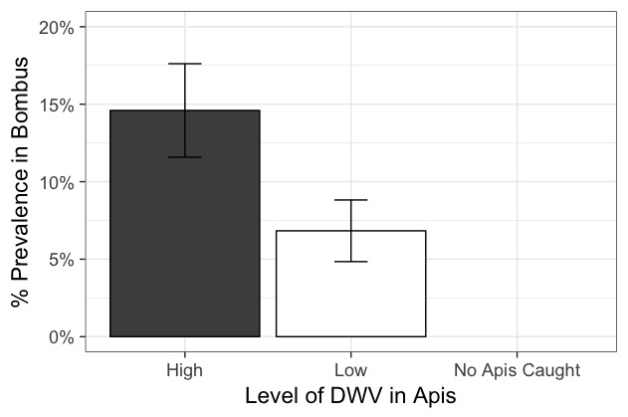
More DWV infected Bumble bees in Sites with High Honey Bee Viral Loads

Slide 21
Research Questions
Part I.
What is the prevalence of RNA viruses in bumble bees
BQCV (75%), DWV (8%)
Are RNA viruses replicating in bumble bee hosts?
YES- Both viruses, both species
Is there evidence for disease spillover from managed honey bees?
YES- bumble bees are more likely to be infected when caught near an apiary and when the apiary has high viral loads
Part II.
What is the role of flowers in virus transmission?
Notes:
Give percentages for prevalences in parentheses.

Slide 22
Research Questions
Part I.
What is the prevalence of RNA viruses in bumble bees
BQCV (75%), DWV (8%)
Are RNA viruses replicating in bumble bee hosts?
YES- Both viruses, both species
Is there evidence for disease spillover from managed honey bees?
YES- bumble bees are more likely to be infected when caught near an apiary and when the apiary has high viral loads
Part II.
What is the role of flowers in virus transmission?
Notes:
Give percentages for prevalences in parentheses.

Slide 23

?
Notes:
Can viruses be left behind by bees when they forage? Can bumble bees become infected after visiting infected flowers? We are still processing the bee samples but we are going to show you the plant data today.

Slide 24
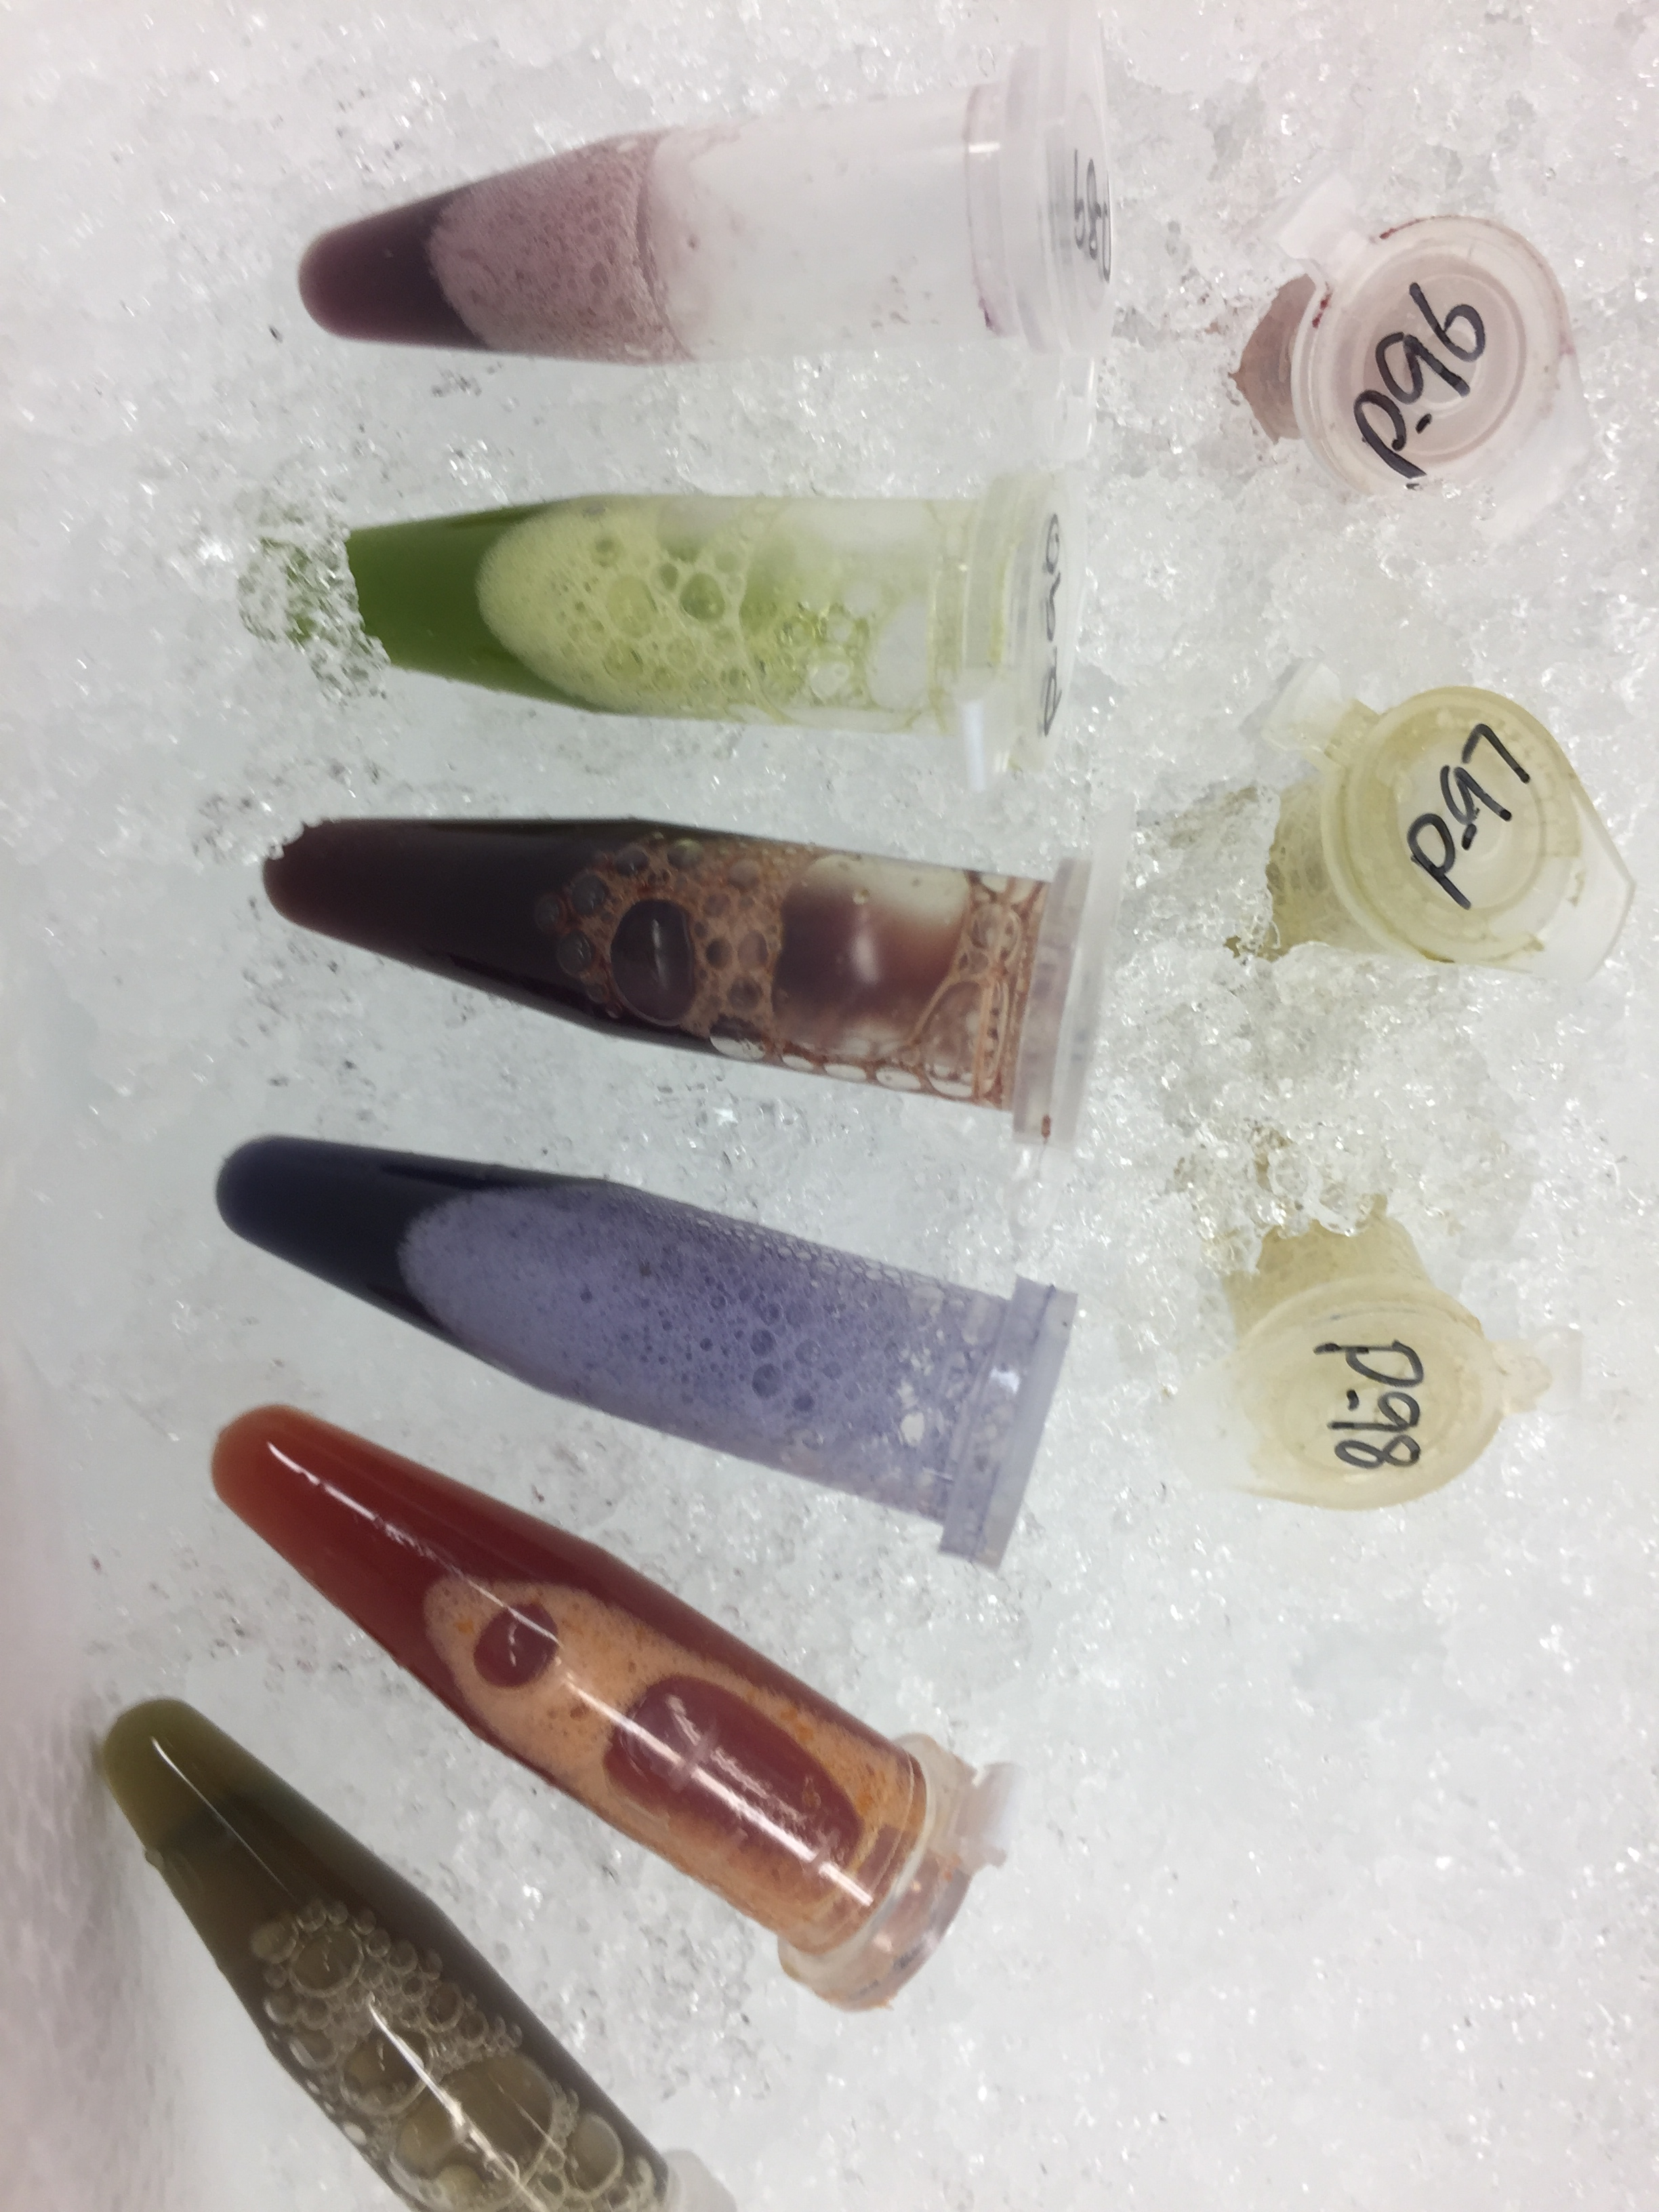

Slide 25
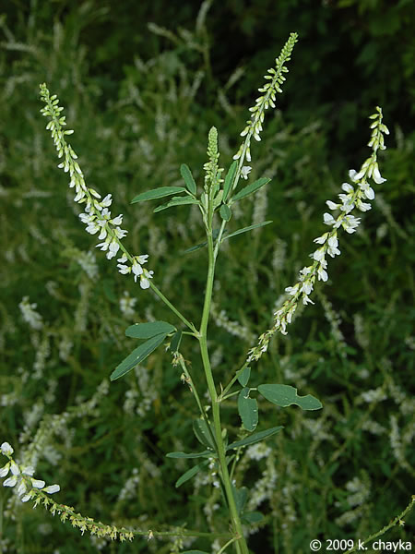
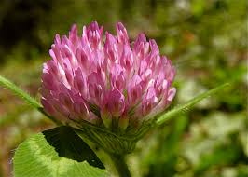
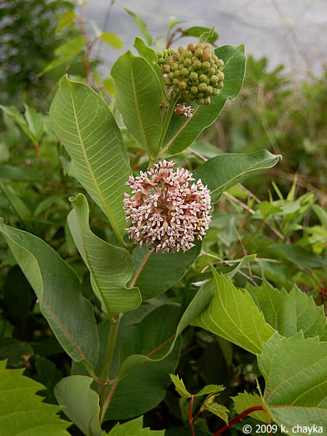
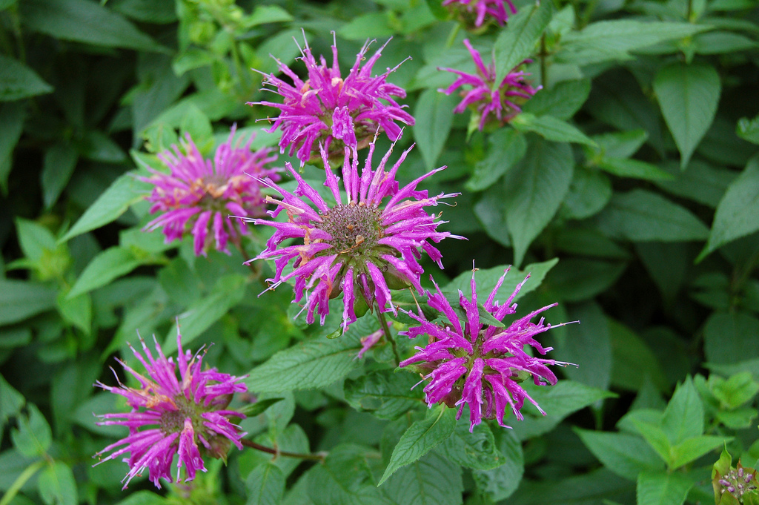
Viruses detected on plants collected only in apiaries!

Slide 26
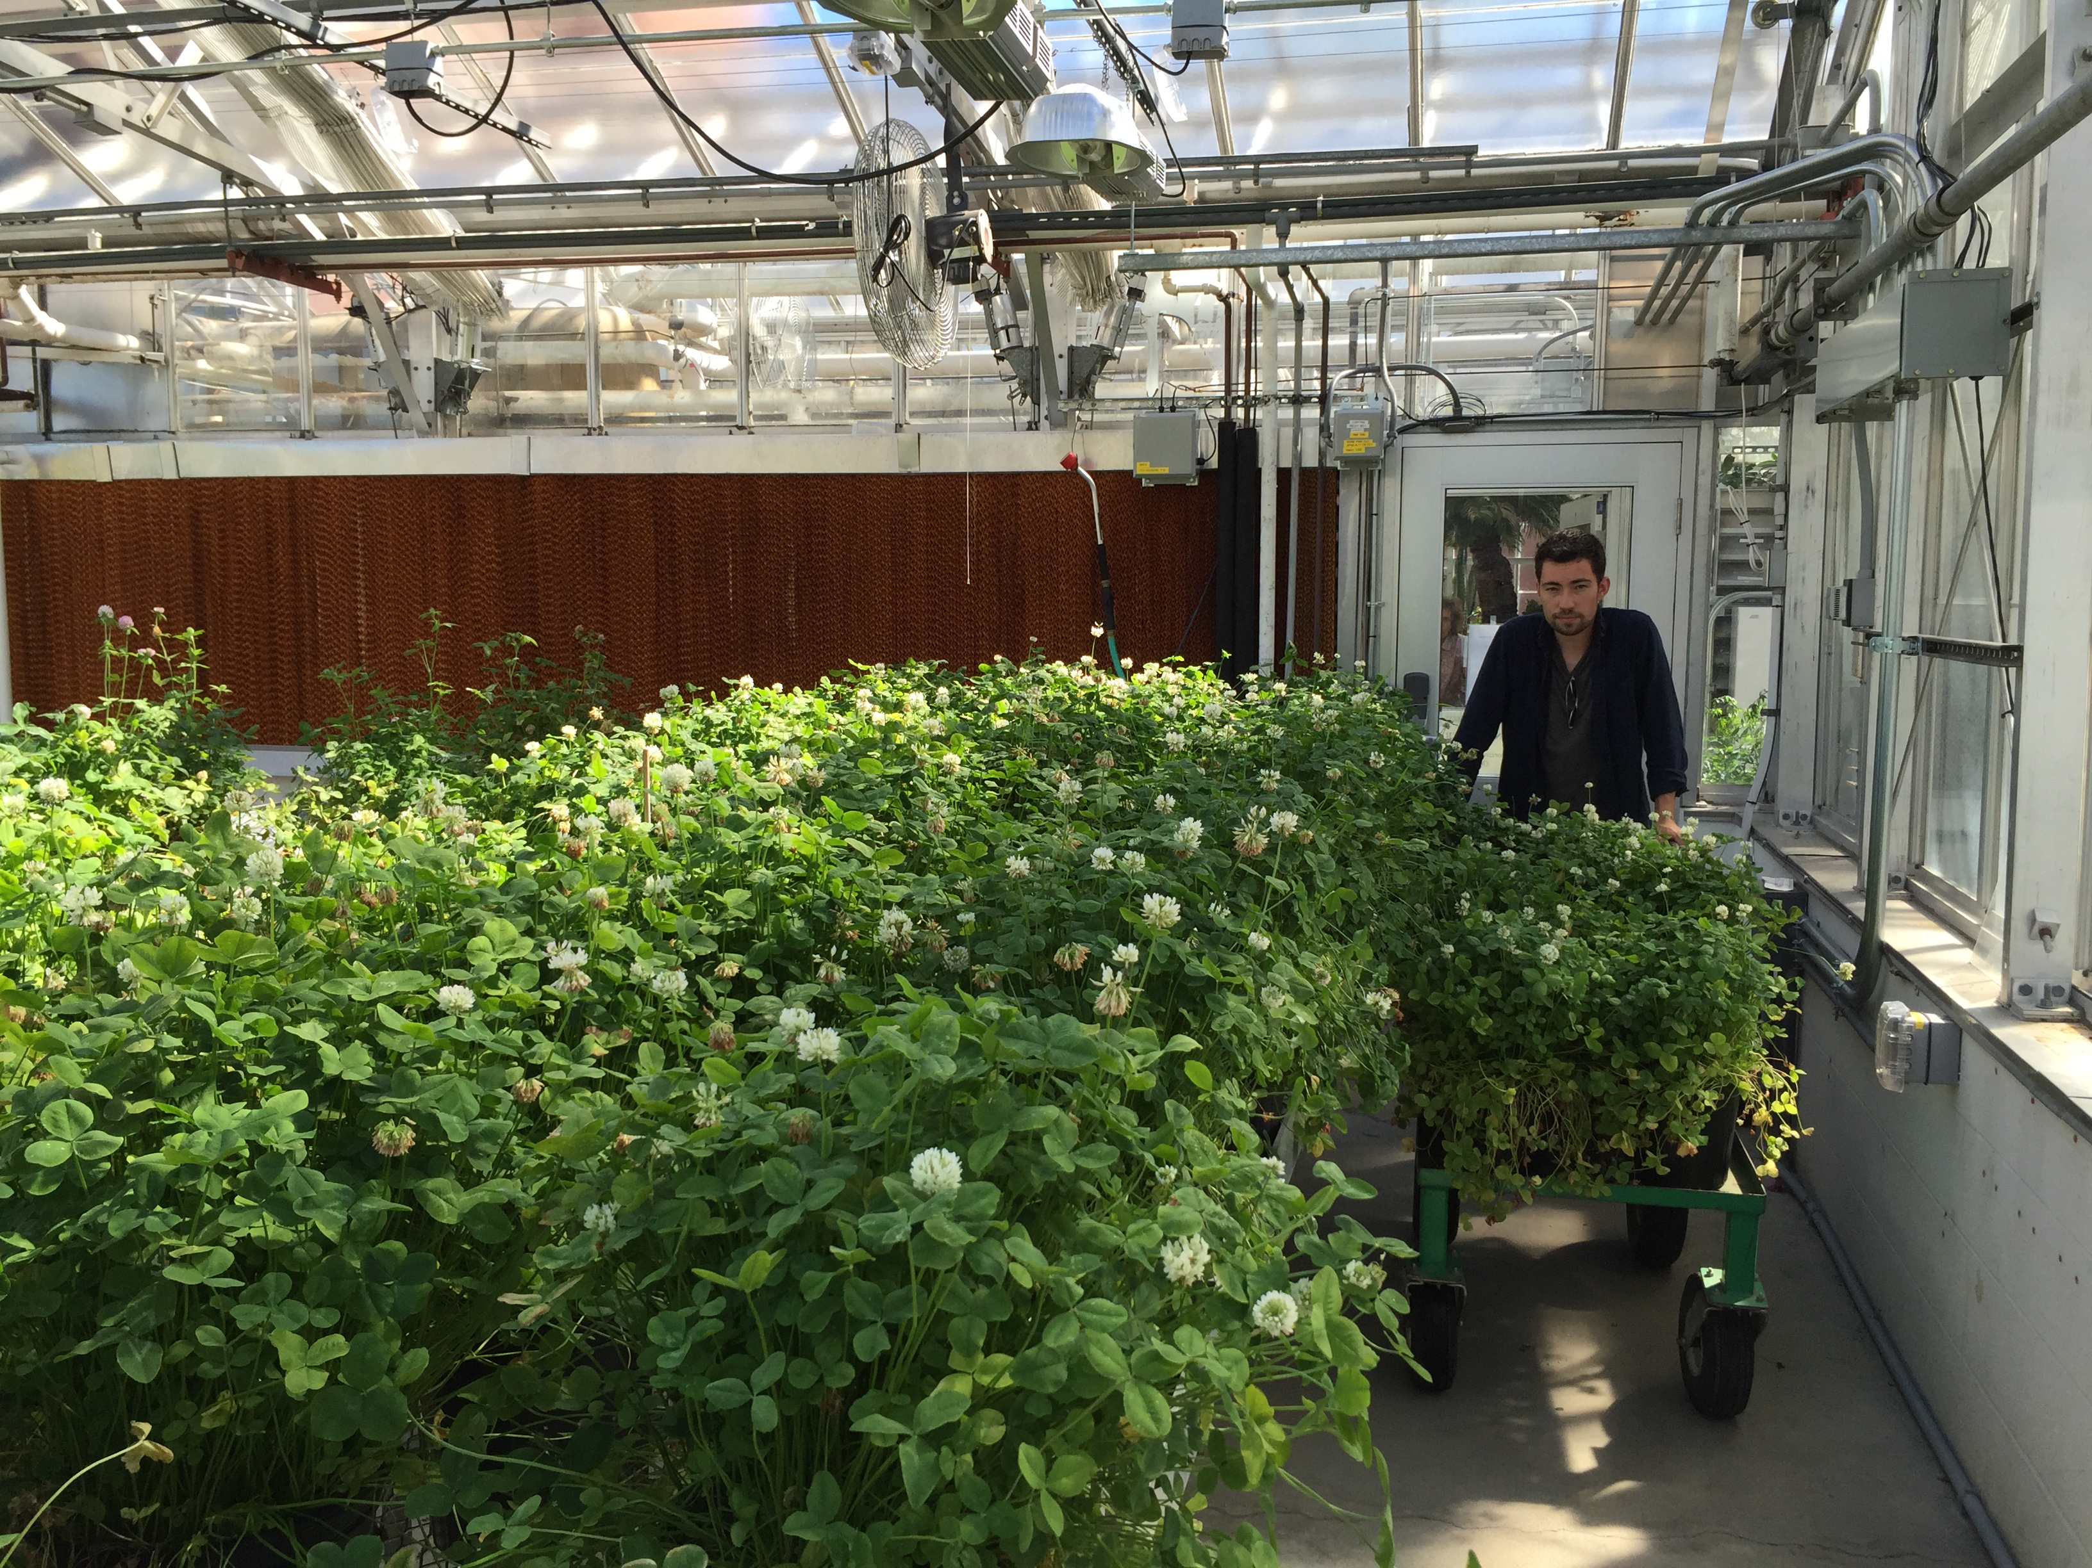

Slide 27
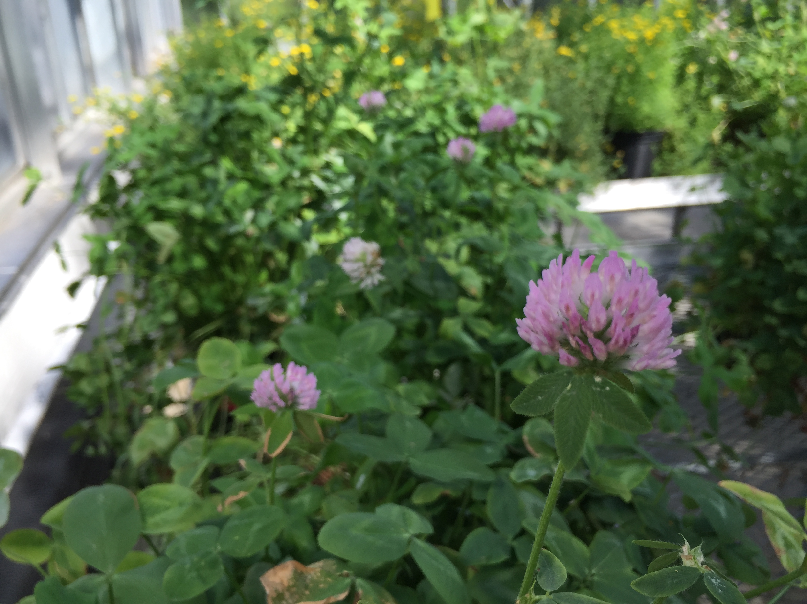
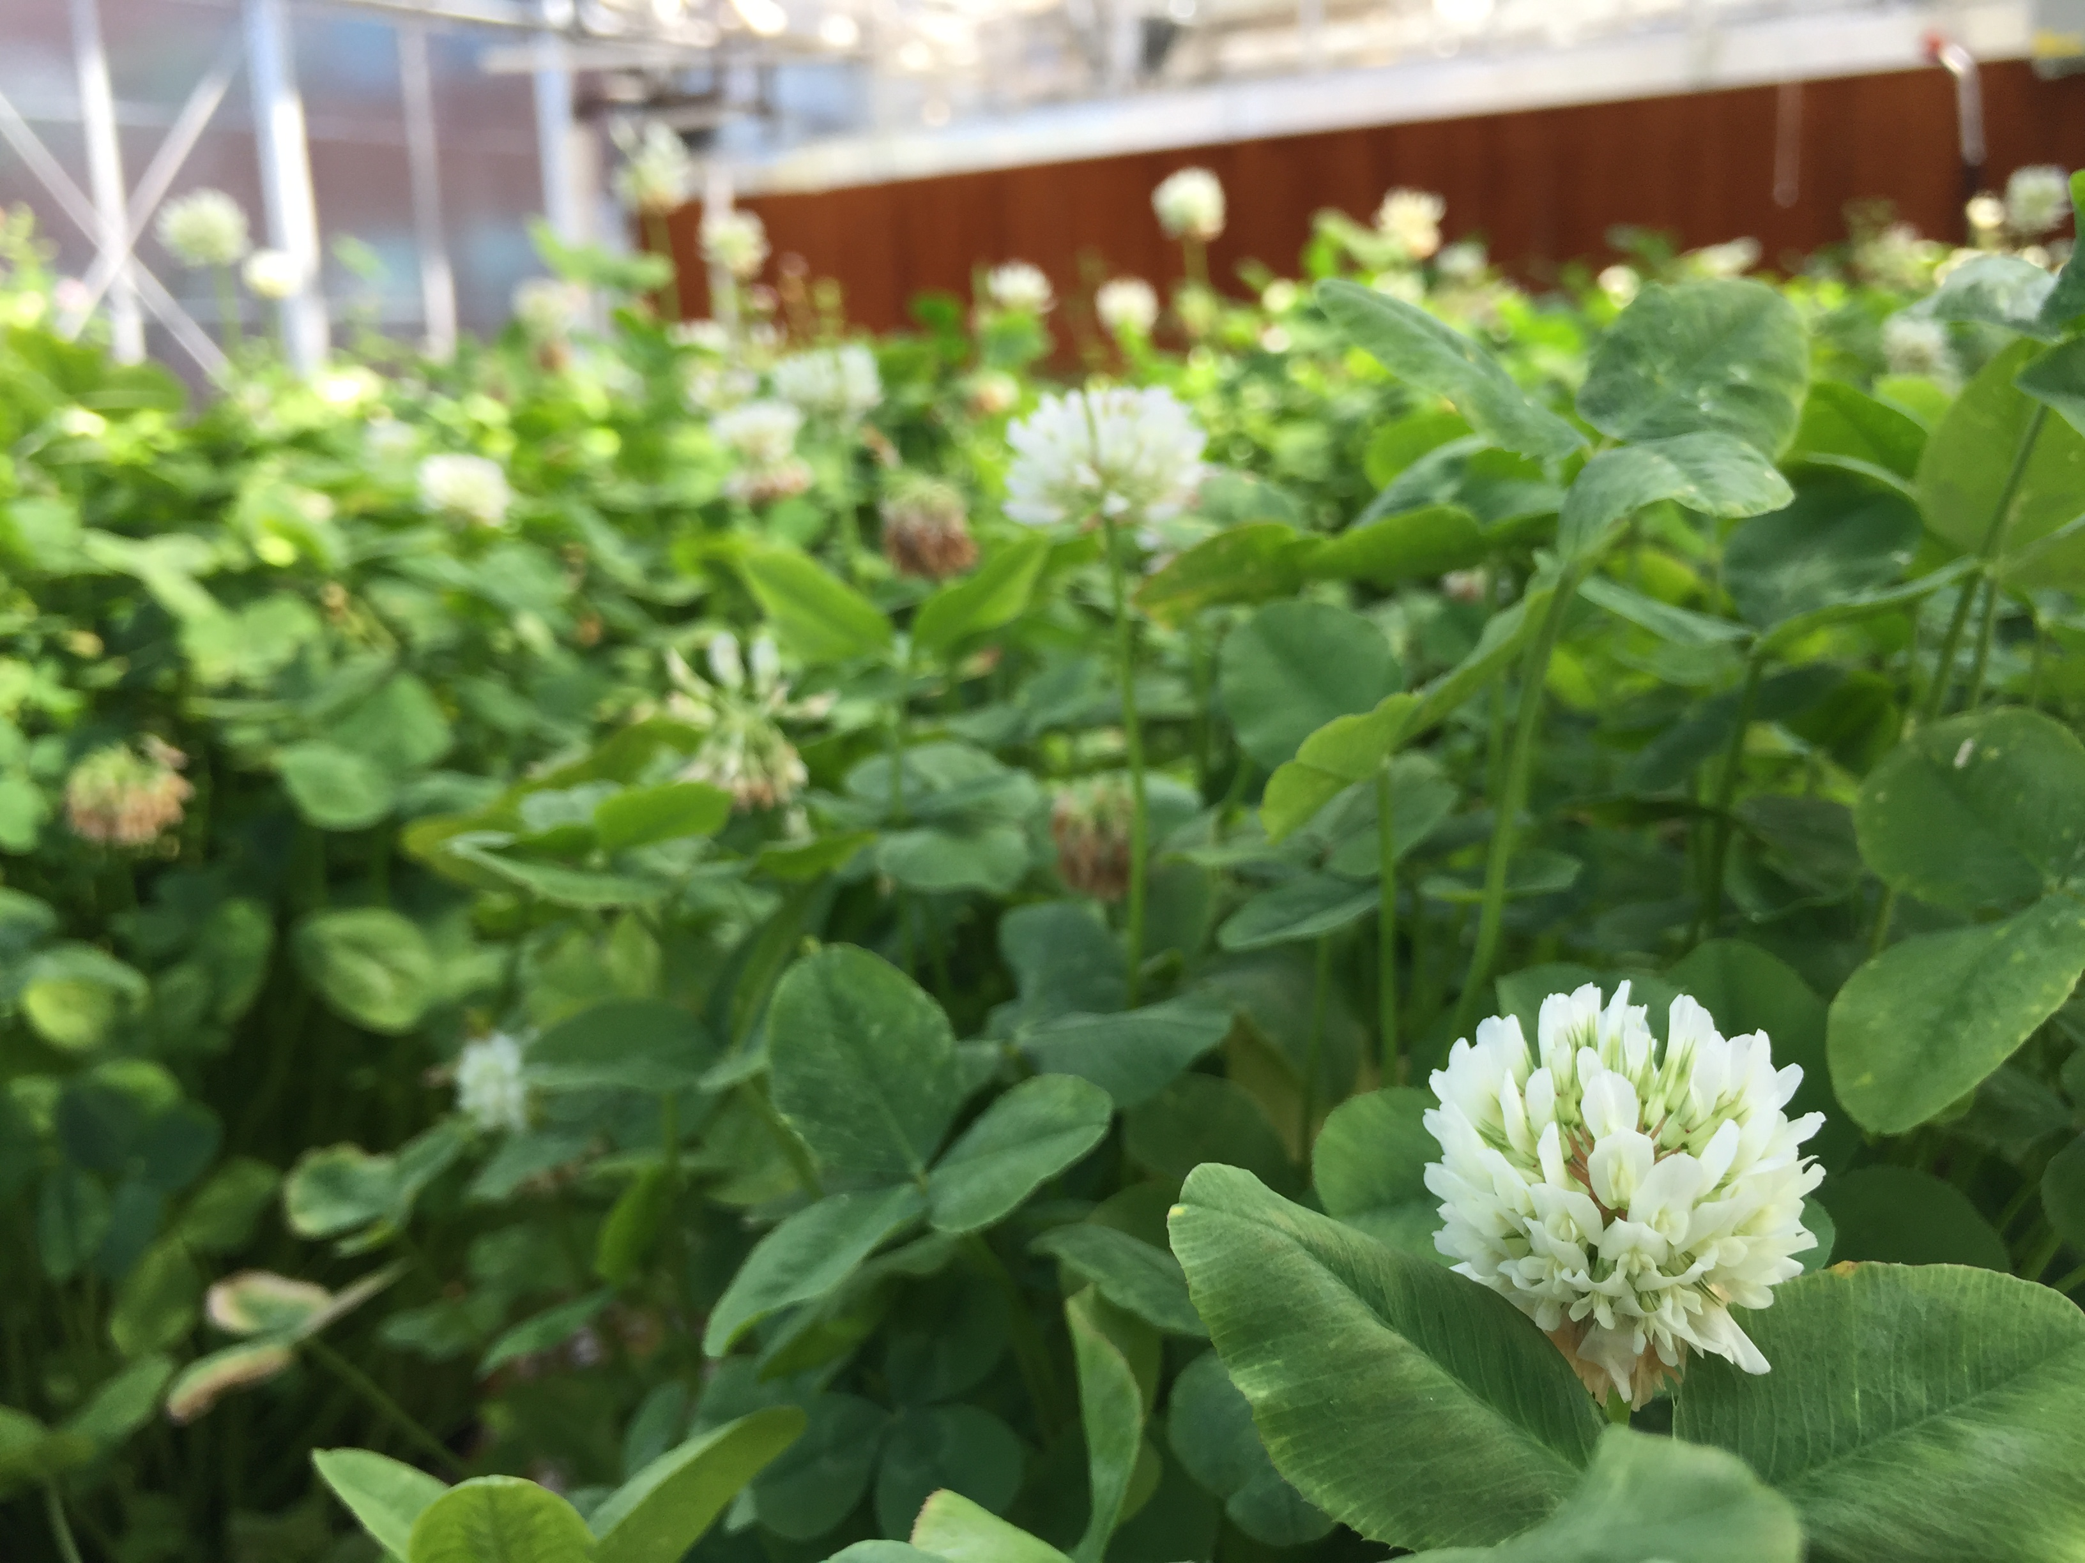
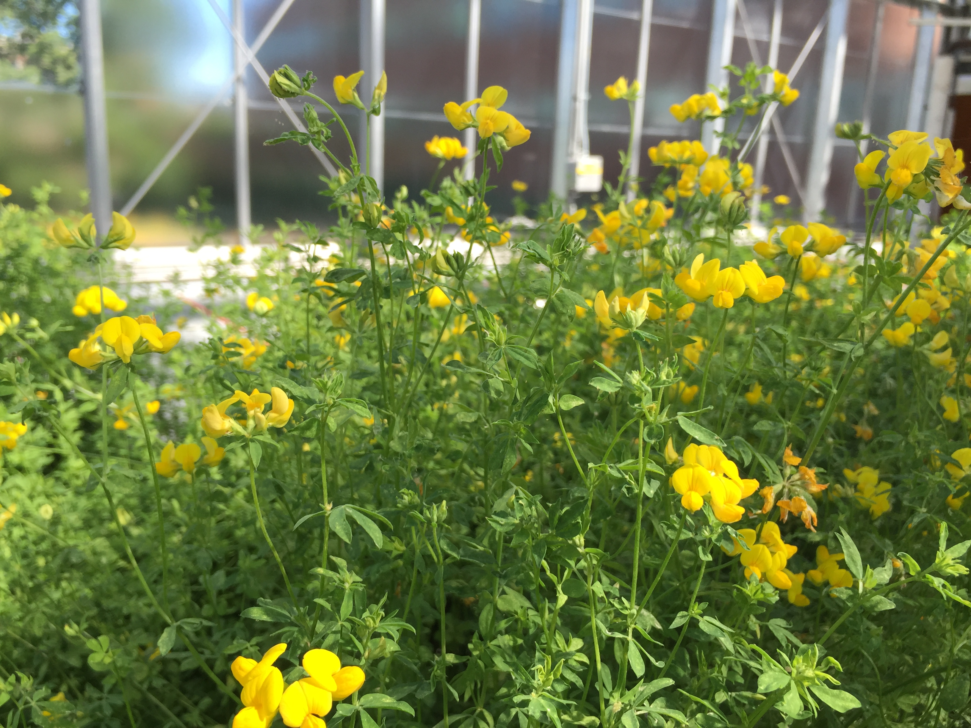
Notes:
We used 3 different plant species to test if some plant species are better are harboring viruses than others. Reasons to believe there might be: For instance floral morphology could matter.. If viruses are shed through fecal matter, plants that only come in contact with the front part of the bee would be less likely to harbor viruses. If the amount of time a bee spends on a flower matters, than flowers with more difficult to access nectaries might be more likely to become infected.

Slide 28
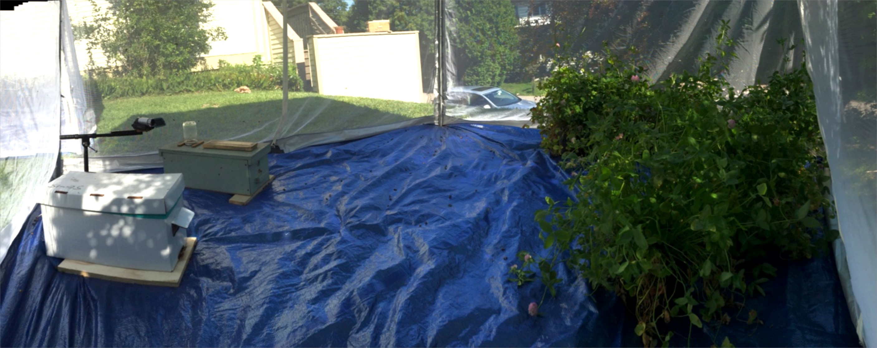
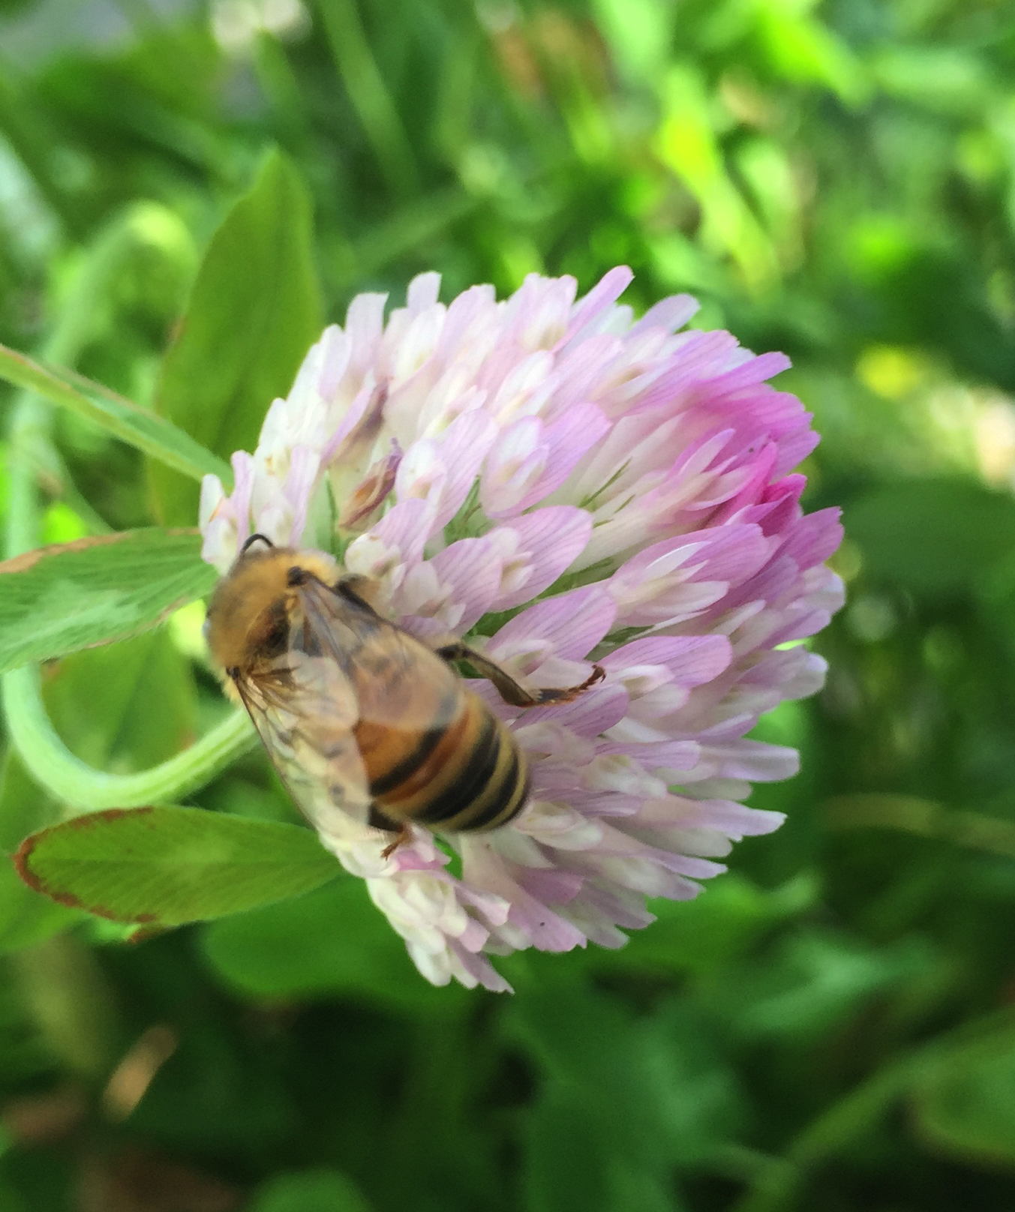
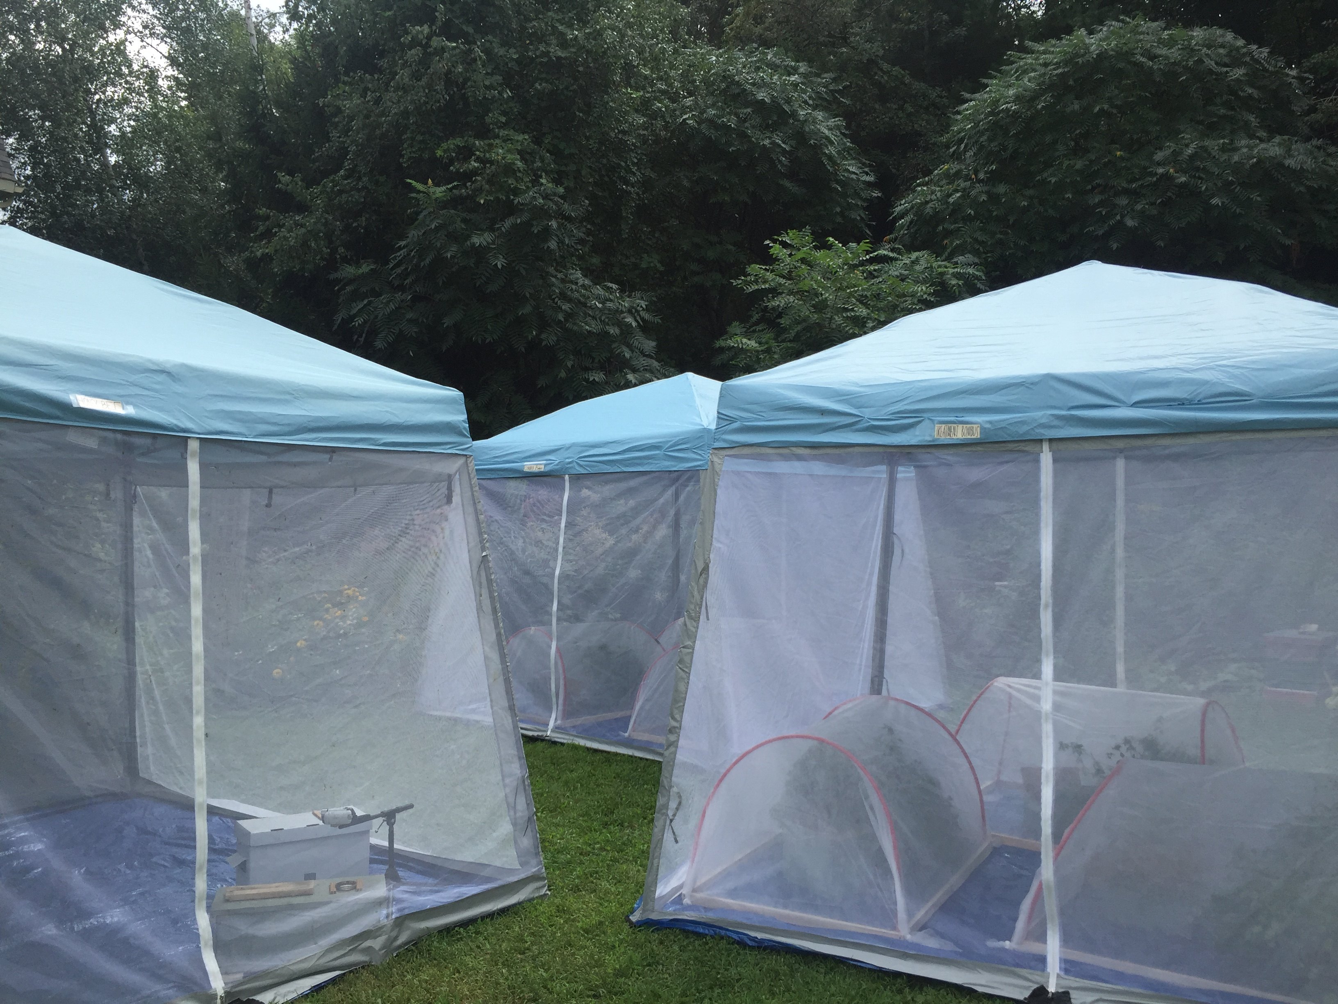

Slide 29
Viruses detected on plants visited by honeybees
Notes:
Switch order of x axis…

Slide 30
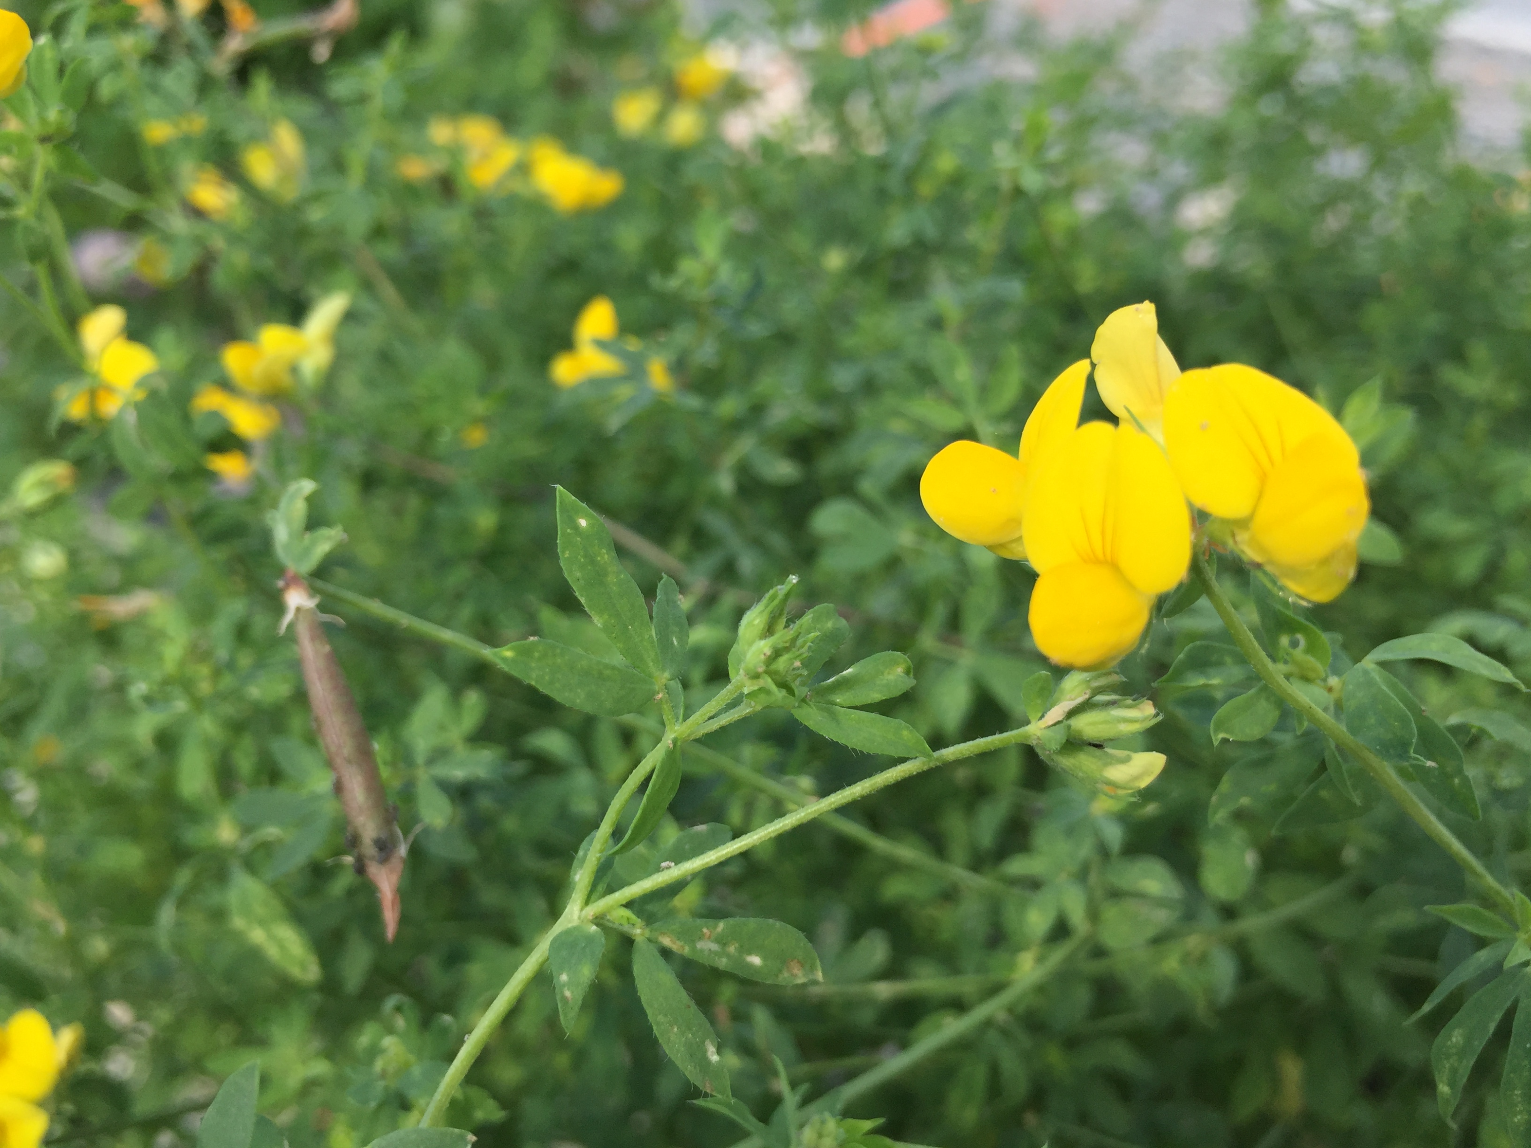
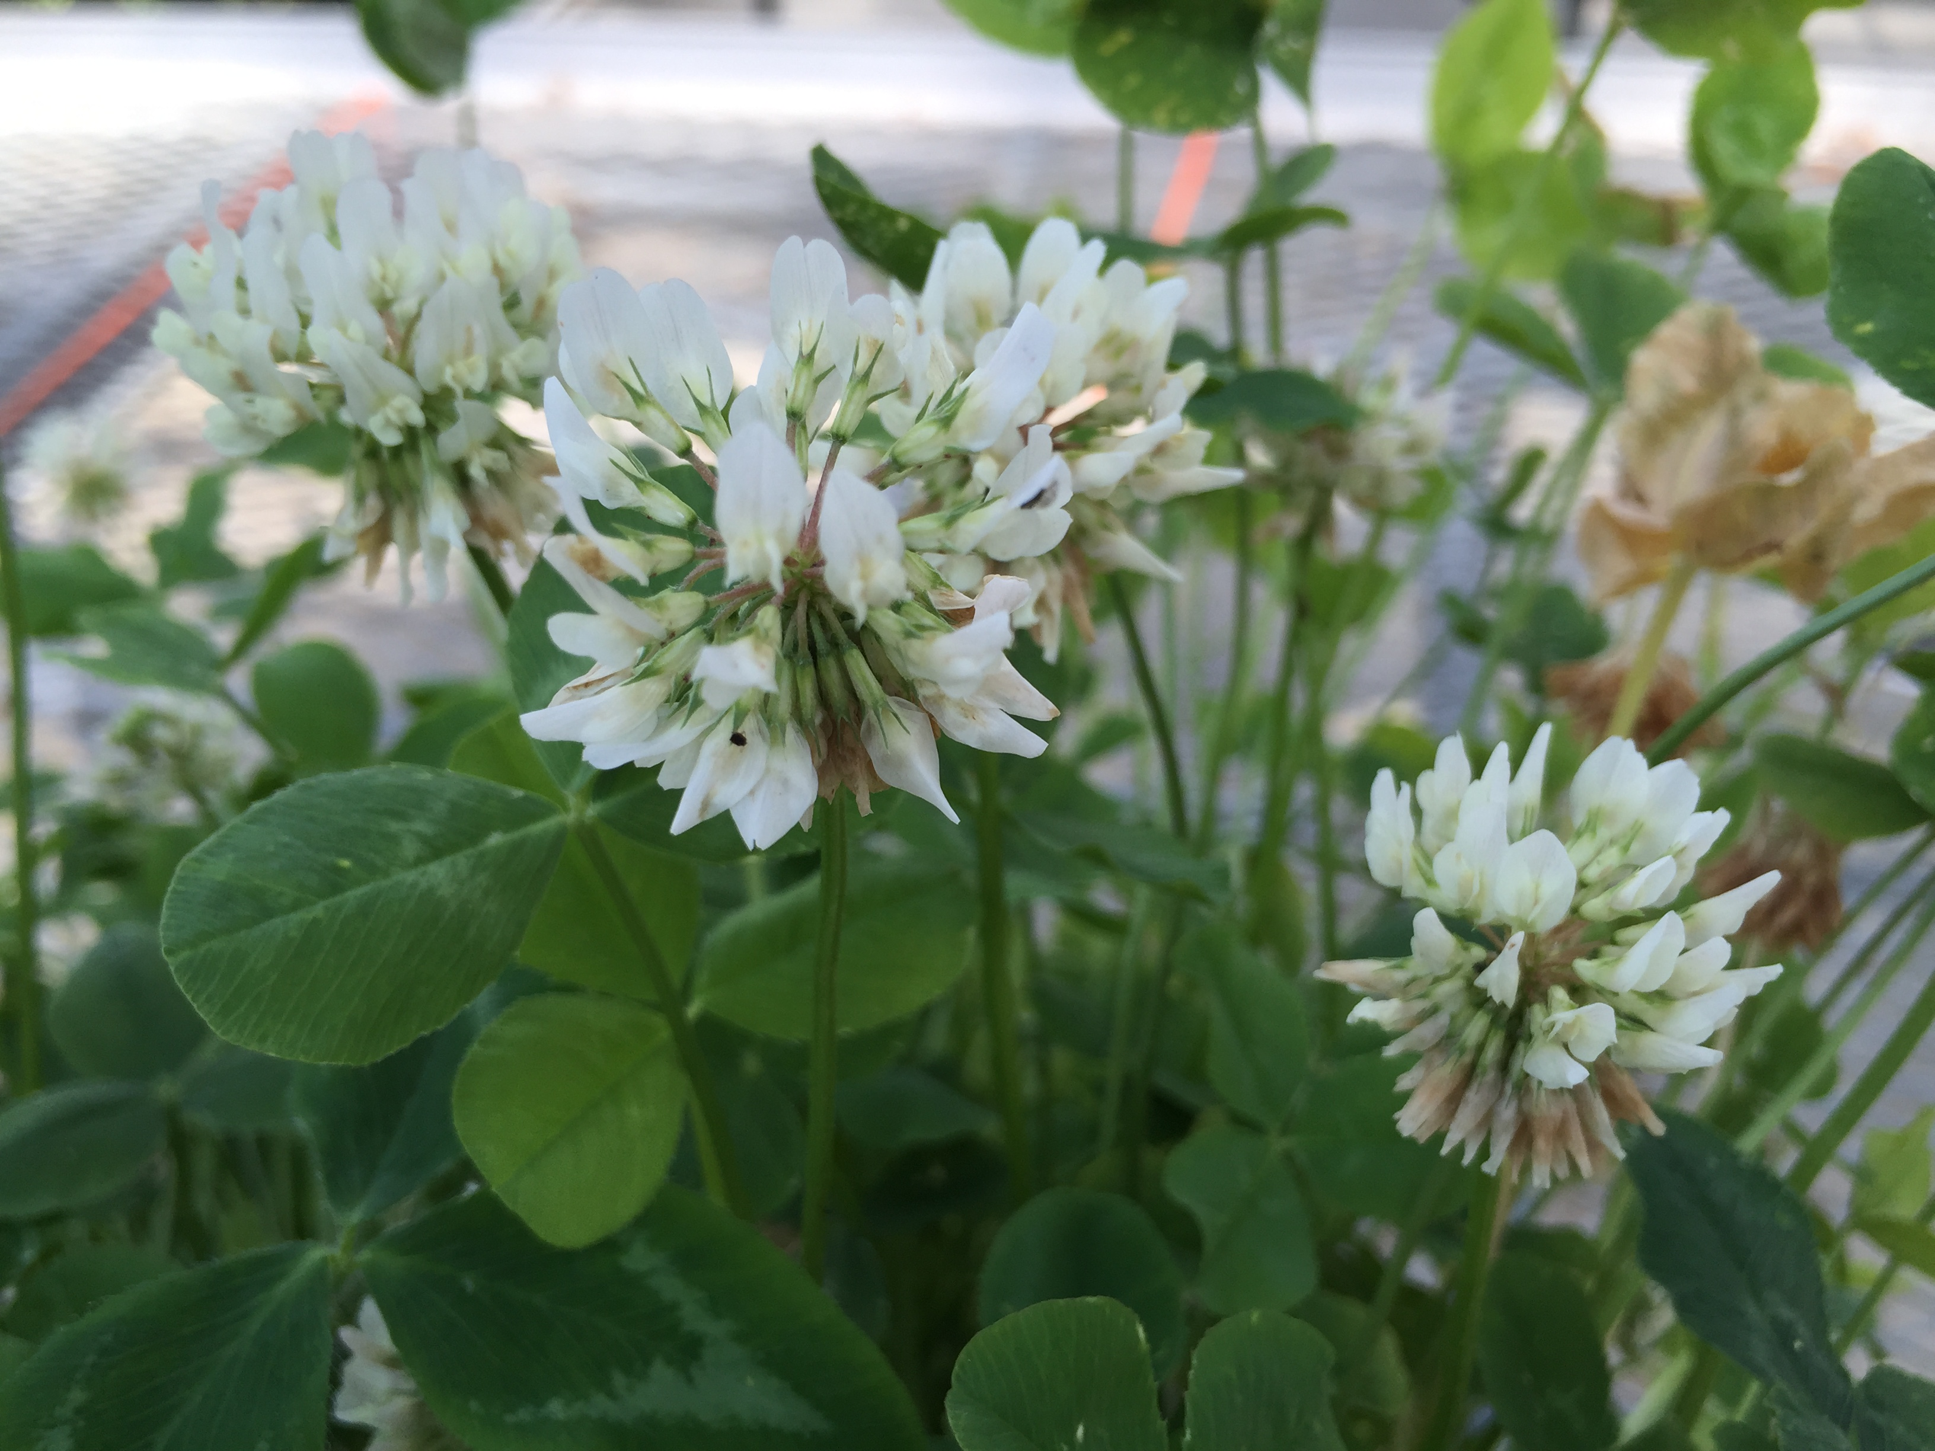
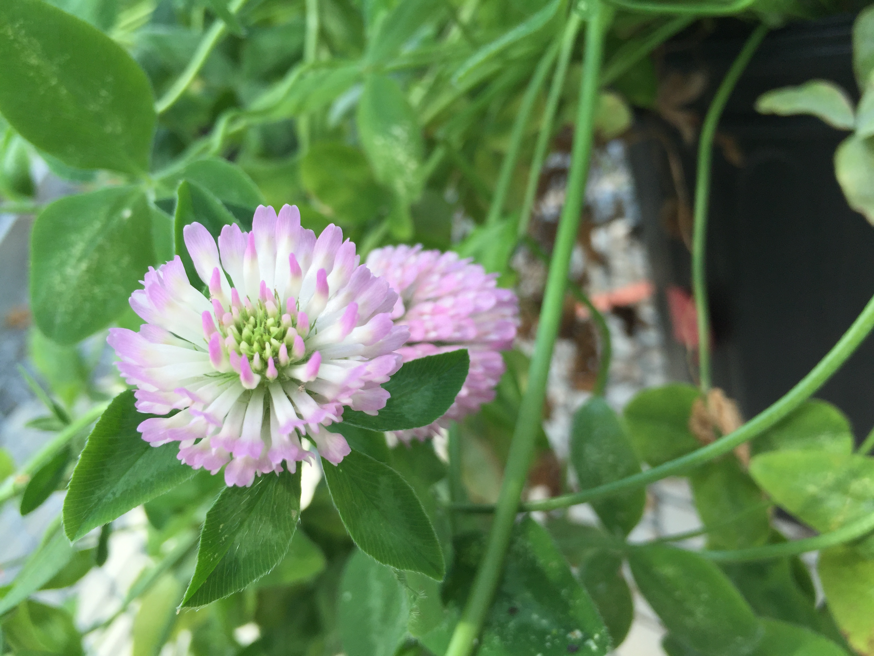
Does plant species matter?
Notes:
If particular plant species are ‘better’ at harboring viruses, they might be avoiding in recommendations for ‘pollinator friendly’ plantings.

Slide 31
Notes:
STATS:
As you can see, viruses are not equally distributed across all species of plants.
Interaction between viruses and plant spp. such that not all viruses are equally distributed across all plant species.

Slide 32
What about visitation rates and foraging time?
~ 3,500 visitations
Over 30 hours of video footage
Notes:
If particular plant species are ‘better’ at harboring viruses, they might be avoiding in recommendations for ‘pollinator friendly’ plantings.

Slide 33
DWV: Visitations and foraging time
Notes:
If particular plant species are ‘better’ at harboring viruses, they might be avoiding in recommendations for ‘pollinator friendly’ plantings.

Slide 34
BQCV: Visitations and foraging time
Notes:
If particular plant species are ‘better’ at harboring viruses, they might be avoiding in recommendations for ‘pollinator friendly’ plantings.

Slide 35
Research Questions
Part I.
What is the prevalence of RNA viruses in bumble bees
BQCV (75%), DWV (8%)
Are RNA viruses replicating in bumble bee hosts?
YES- Both viruses, both species
Is there evidence for disease spillover from managed honey bees?
Yes- bumble bees are more likely to be infected when caught near an apiary and when the apiary has high viral loads
Part II.
What is the role of flowers in disease transmission?
Bees can deposit viruses on flowers
Plant species and virus matter!

Slide 36
This Summer’s Questions…
Can bees become infected after visiting an infected flower?
Are there differences in how viruses are shed?
(fecally vs. orally)
Does floral morphology matter?

Slide 37
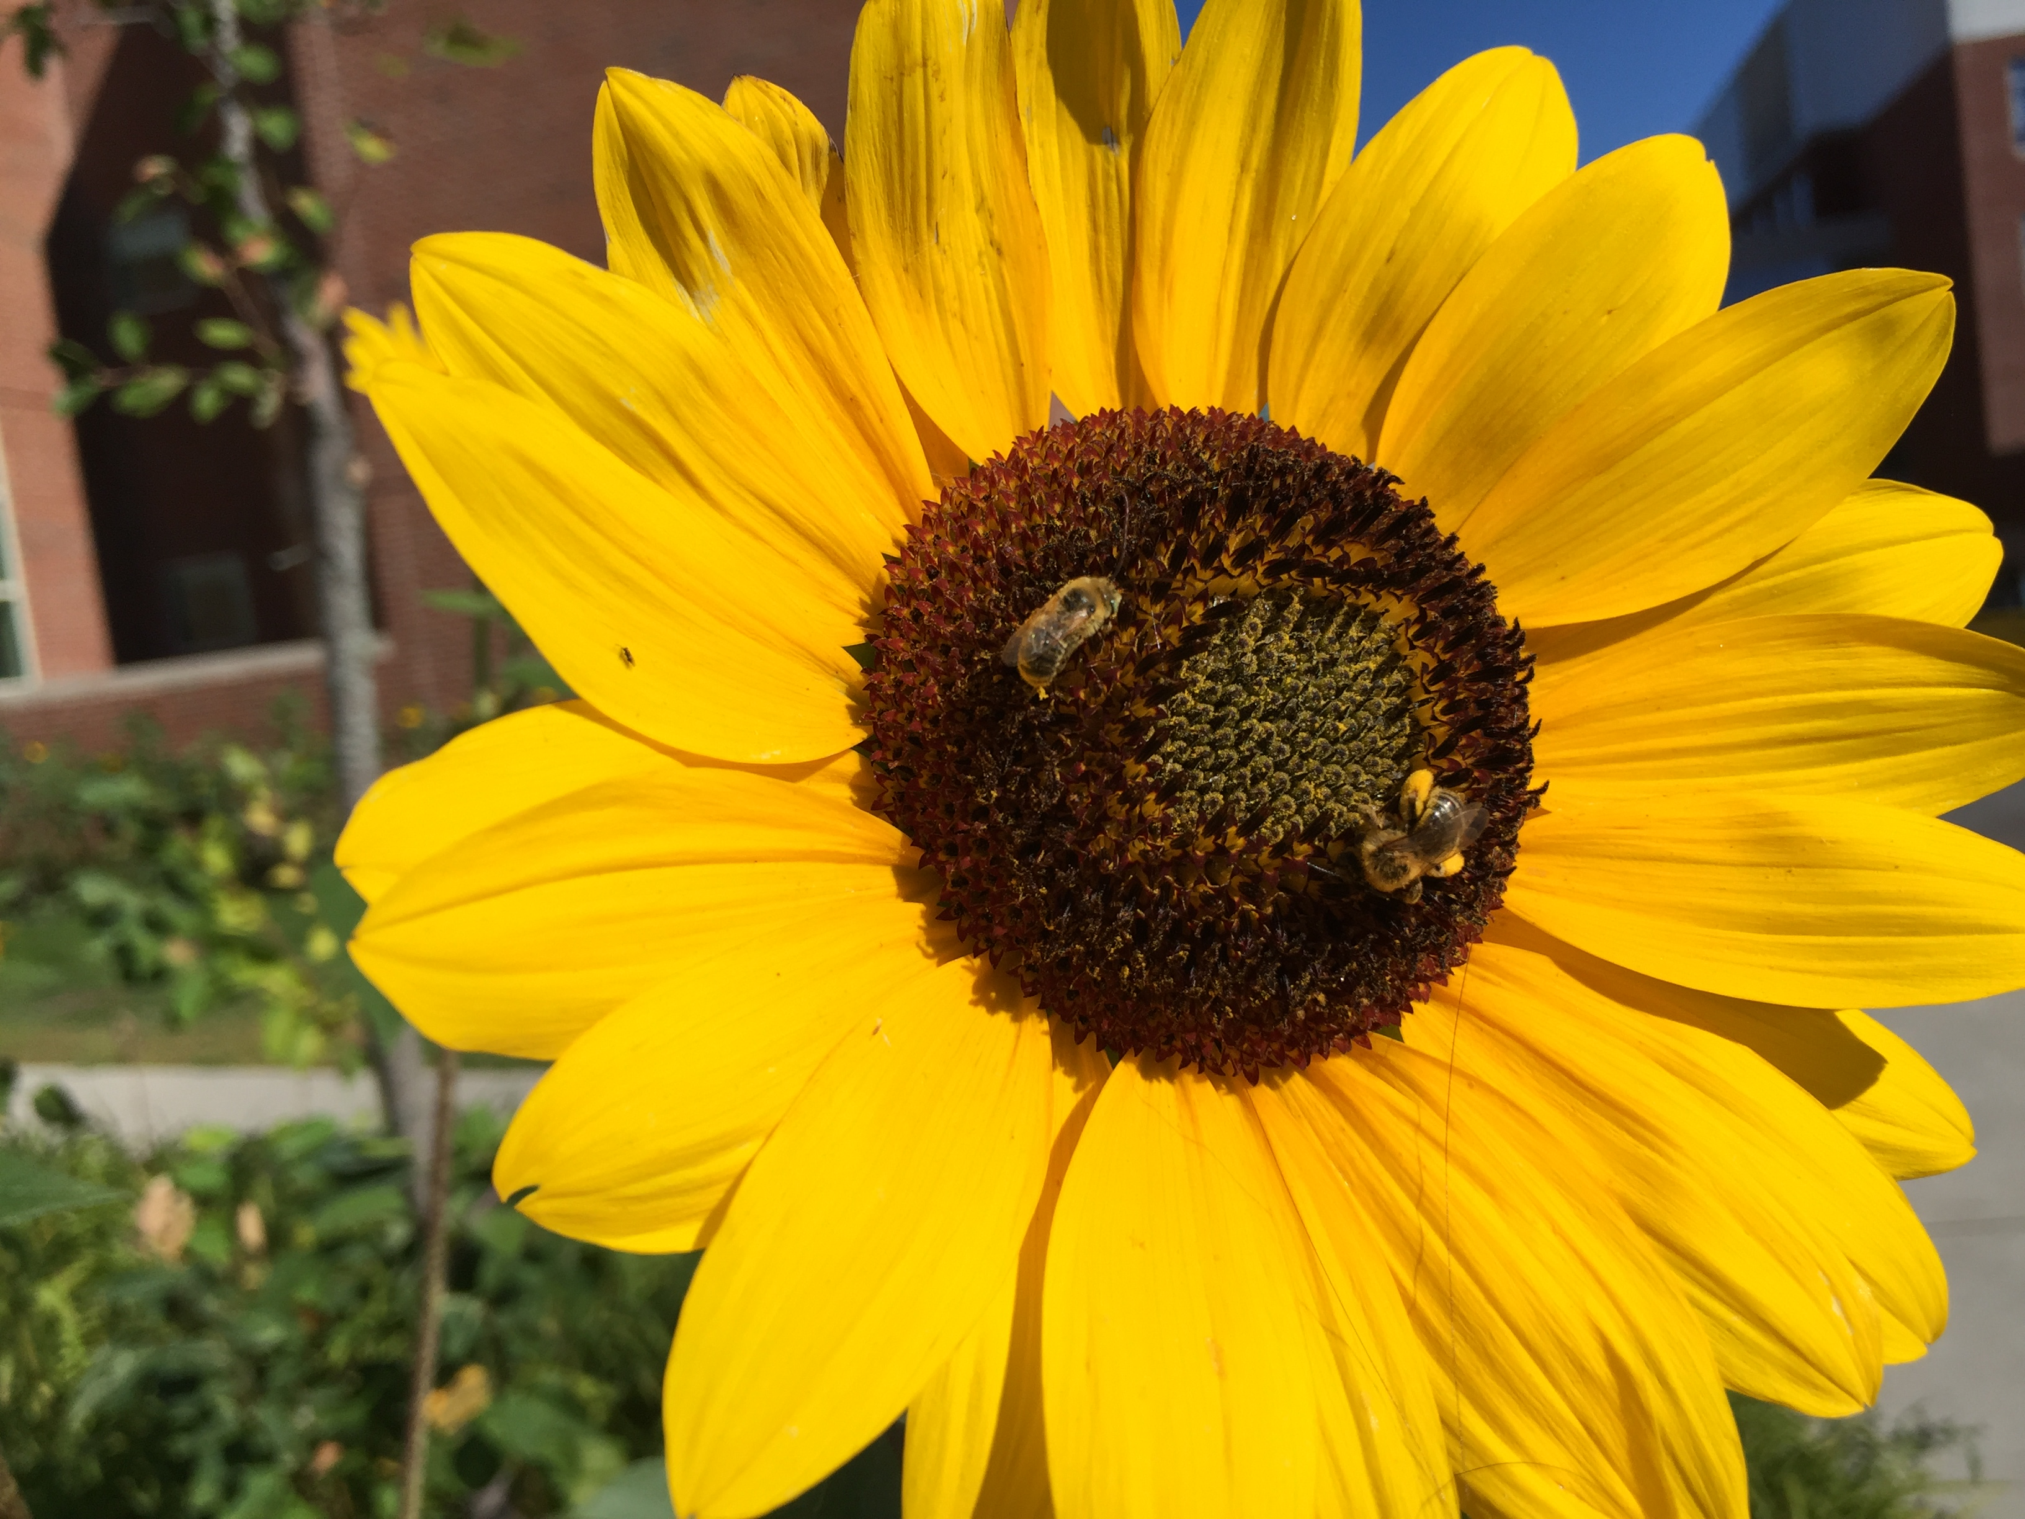

Slide 38
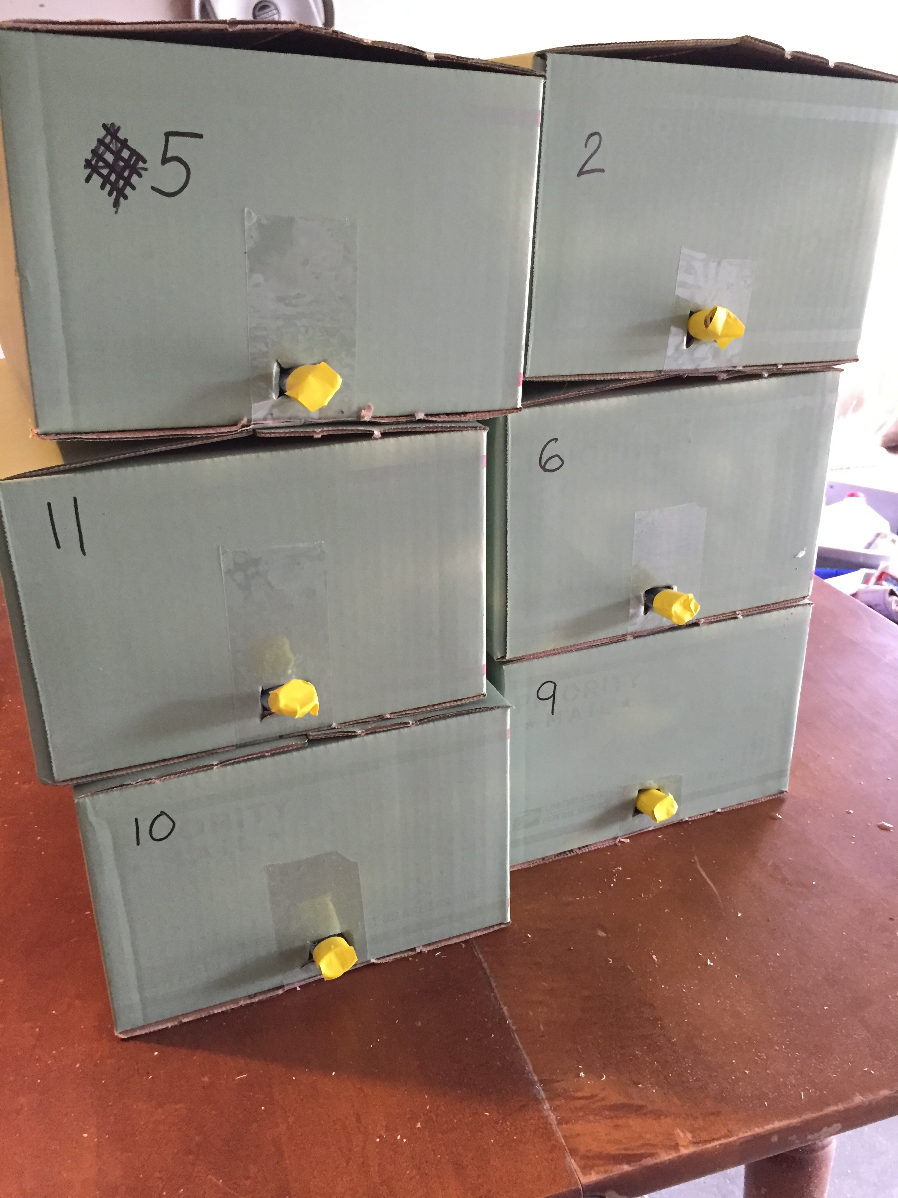
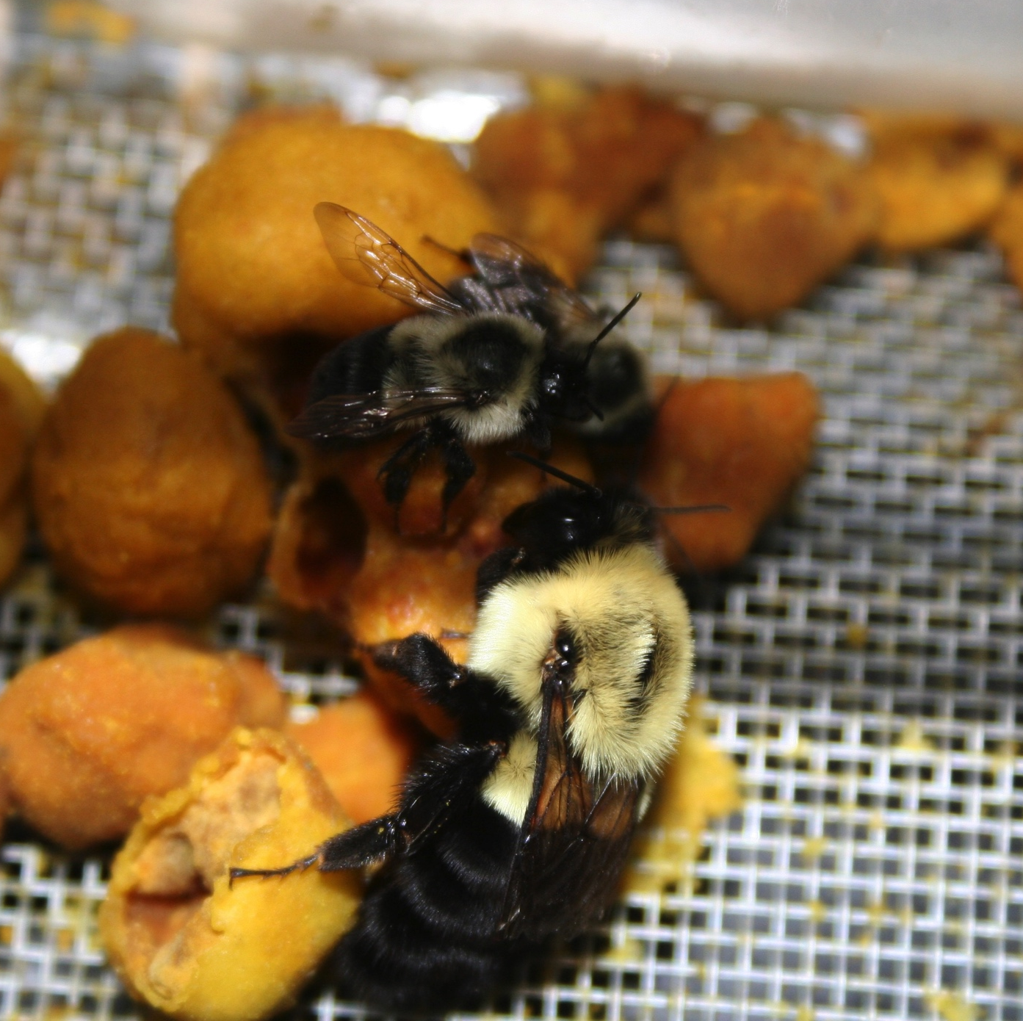

Slide 39
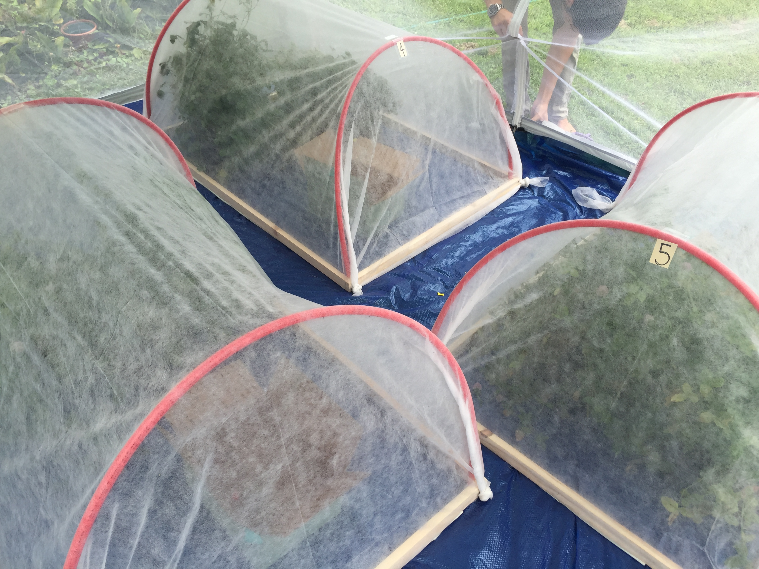
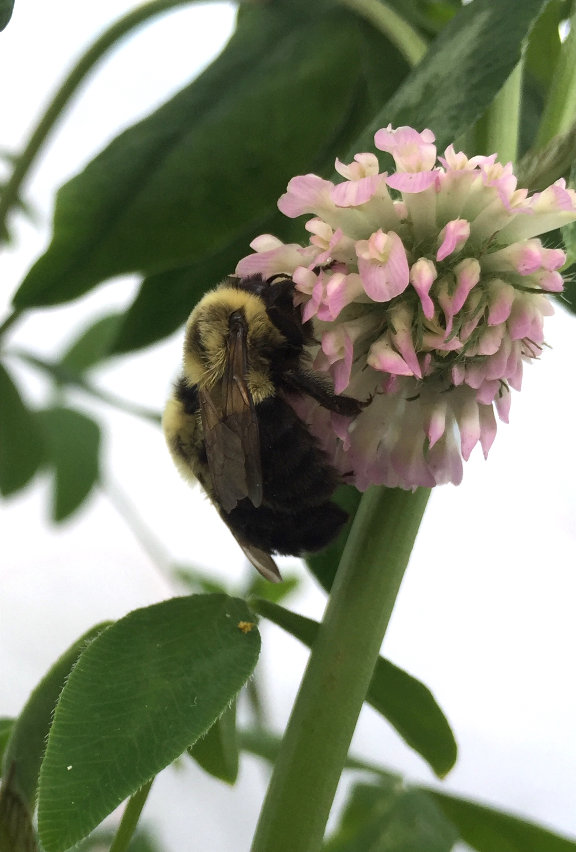

Slide 40
“Clean” Commercial Bumble Bees are hard to find…
Virus prevalence upon arrival for 9 different commercial bumble bee colonies.

Slide 42
BQCV More Prevalent in bimaculatus
*
GLMMs: BQCV: P <0.001; DWV: P = 0.6
Notes:
Photos of bees
Sample sizes
Change color scheme

Slide 43
More replicating BQCV in B. Bimaculatus
*
GLMM: BQCV: P < 0.0001
Notes:
Photos of bees
Sample sizes
Change color scheme

